Slide 1
Movies and TV Shows Analysis on Netflix
Dicky Alvion Abrar

Slide 2
STAGES
01
02
DATA SOURCE AND DATA CLEANING PROCESS
INTRODUCTION
03
04
ANALYSIS
CONCLUSION
01
02
03
04

Slide 3
01
INTRODUCTION
01

Slide 4

INTRODUCTION
Netflix has many movies on its platform, this makes people confused to determine the choice of movies to watch.
This analysis is done to see an overview of Netflix and can be used for audiences in determining their choice of films.

Slide 5
01
DATA SOURCES AND DATA CLEANING
02

Slide 6
Data Requirement
This data comes from the Kaggel Dataset. For more details can be seen at the link below:
https://www.kaggle.com/datasets/victorsoeiro/netflix-tv-shows-and-movies

Slide 7
About Data and Variables
Table 1: titles
id: The title ID on JustWatch.
title: The name of the title.
show_type: TV show or movie.
description: A brief description.
release_year: The release year.
age_certification: The age certification.
runtime: The length of the episode (SHOW) or movie.
genres: A list of genres.
production_countries: A list of countries that produced the title.
seasons: Number of seasons if it's a SHOW.
imdb_id: The title ID on IMDB.
imdb_score: Score on IMDB.
imdb_votes: Votes on IMDB.
tmdb_popularity: Popularity on TMDB.
tmdb_score: Score on TMDB.
Table 1: credits
person_ID: The person ID on JustWatch.
id: The title ID on JustWatch.
name: The actor or director's name.
character_name: The character name.
role: ACTOR or DIRECTOR.

Slide 8
Data Cleaning
Change Data Type
Change Data Structure
Joining Variables

Slide 9
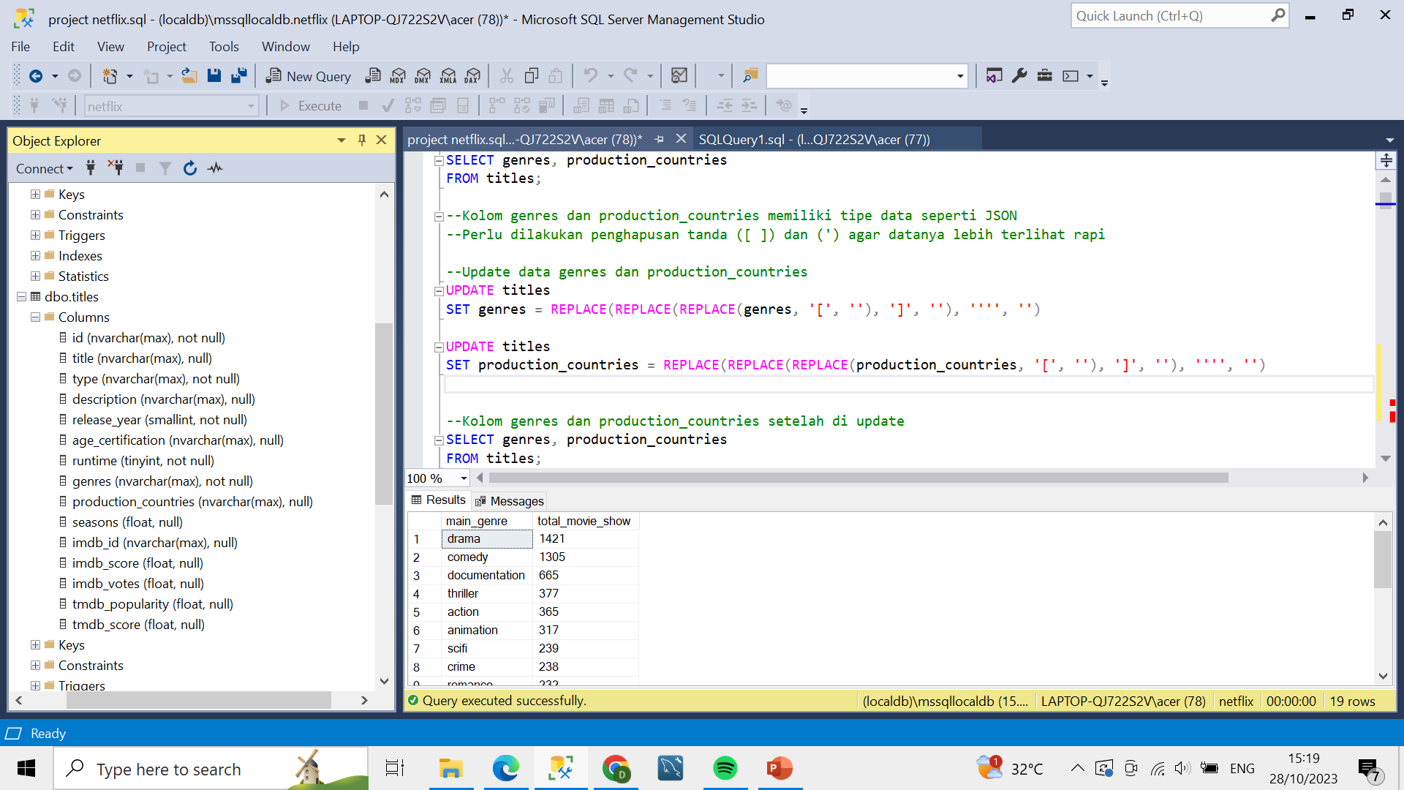
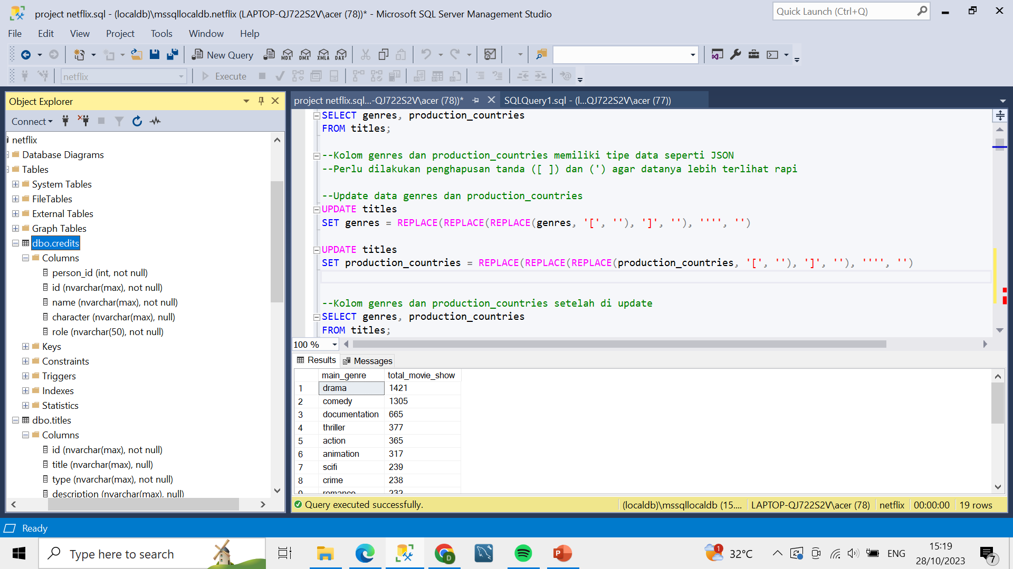
DATA TYPE
Titles table data type
Credits table data type

Slide 10
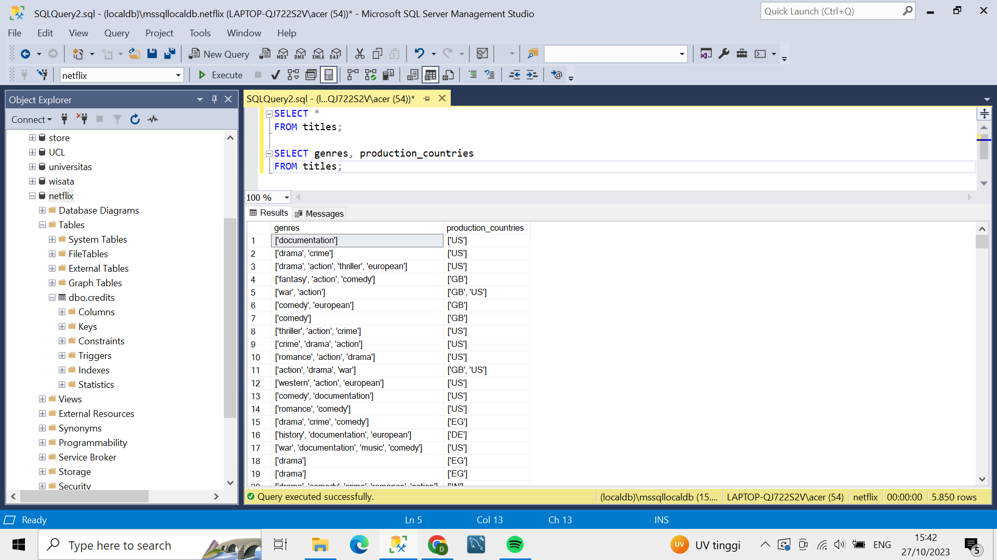
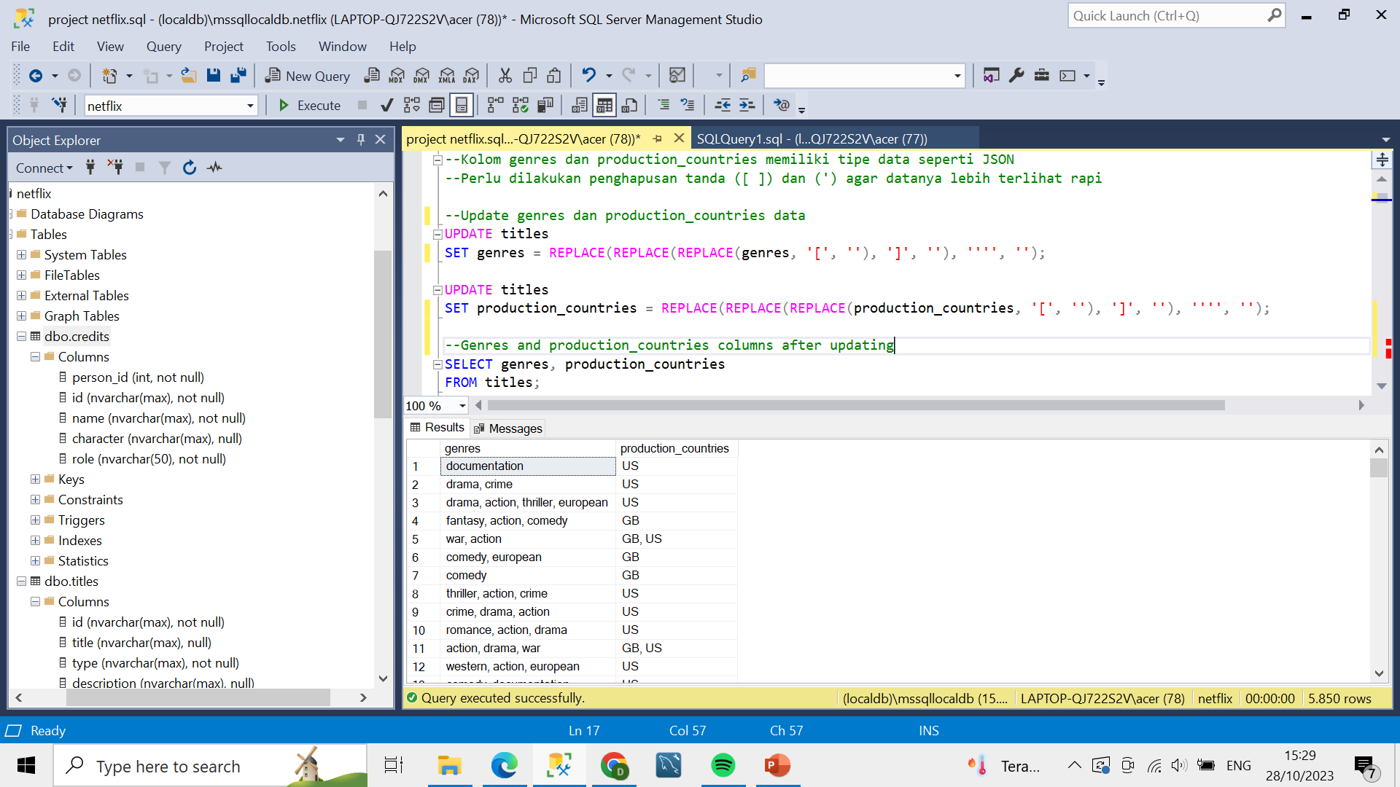
CHANGE DATA STRUCTURE
genres and production_countries columns look like JSON data types
It needs to be converted into a regular data structure to make it easier to perform analysis

Slide 11
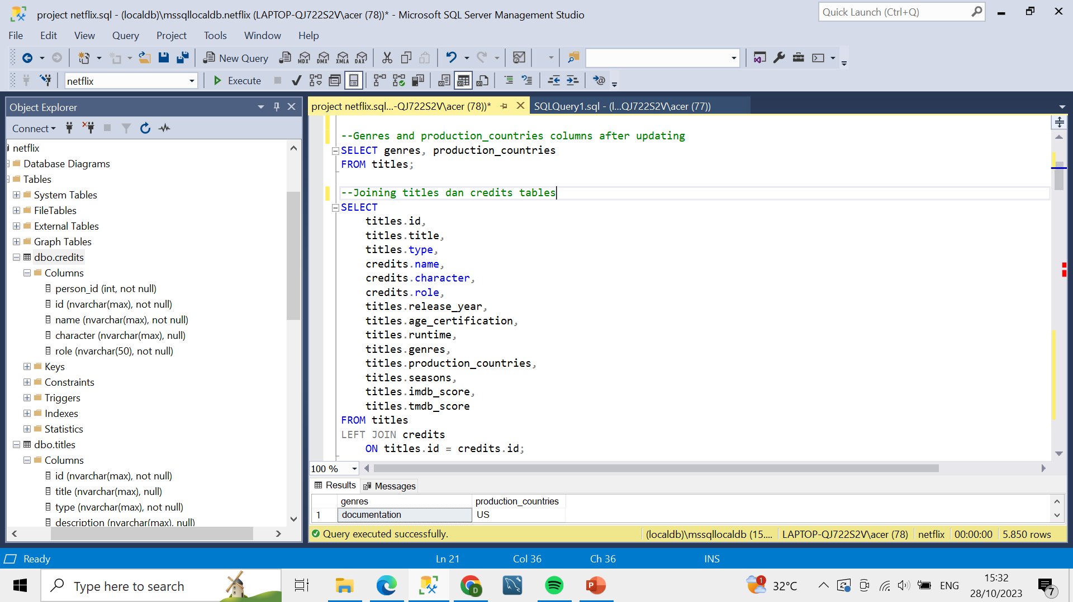
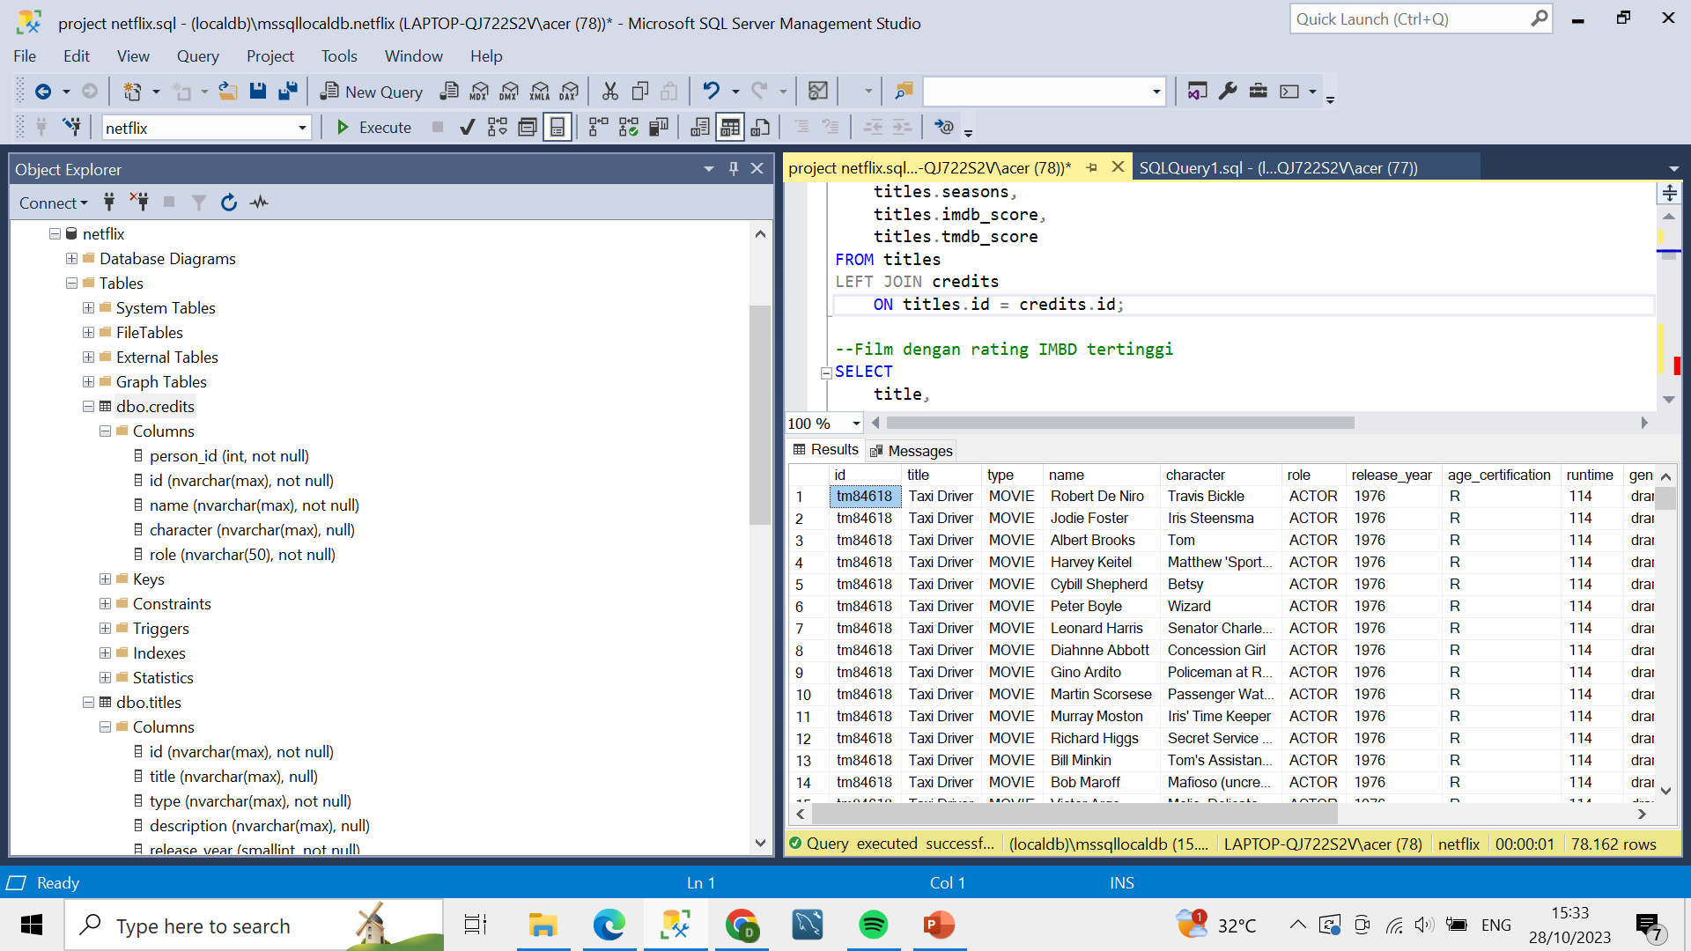
JOINING TABLE
Query
Result

Slide 12
01
ANALYSIS
03

Slide 13
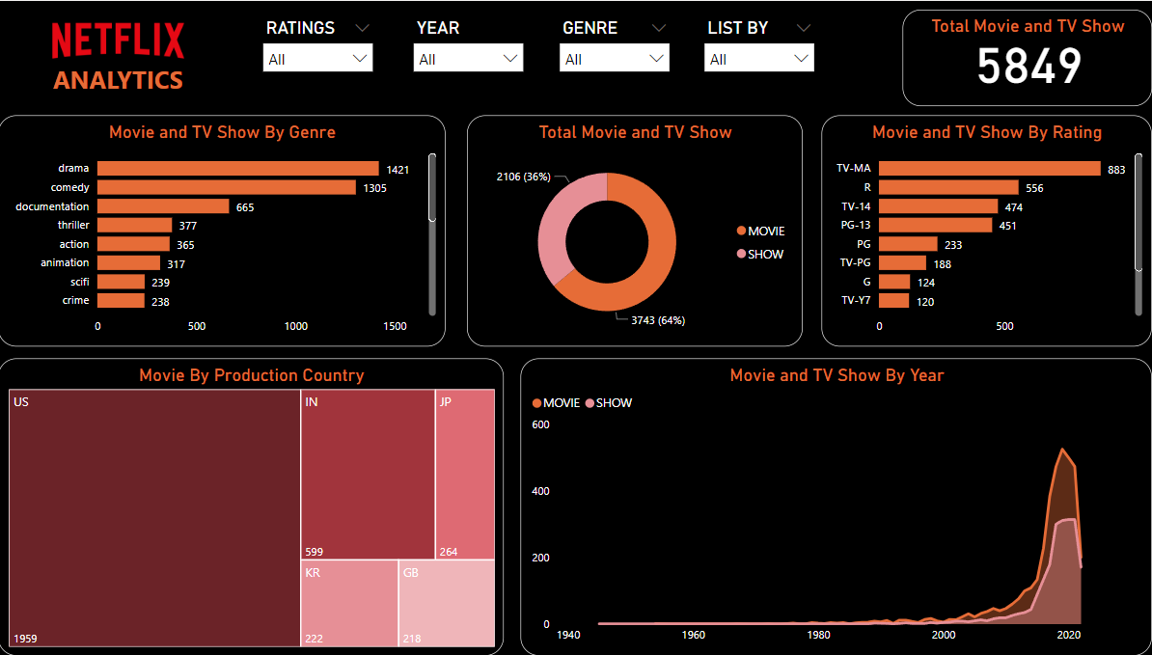
Total Movies And TV Show
There are 5,849 movies and TV shows on Netflix with 64% being movies and 36% being TV shows

Slide 14
Movies And TV Show by Genre
The most popular genres were drama (1,421), comedy (1,305), and thriller (377).

Slide 15
Movies And TV Show by Rating
The most popular ratings are TV-MA (556) and R (883)

Slide 16
Movies And TV Show by Year
The production year that produced the most content for Netflix was 2019

Slide 17
Movies And TV Show by Country
The United States is the country that produces the most Netflix content. It was followed by India and Japan.

Slide 18
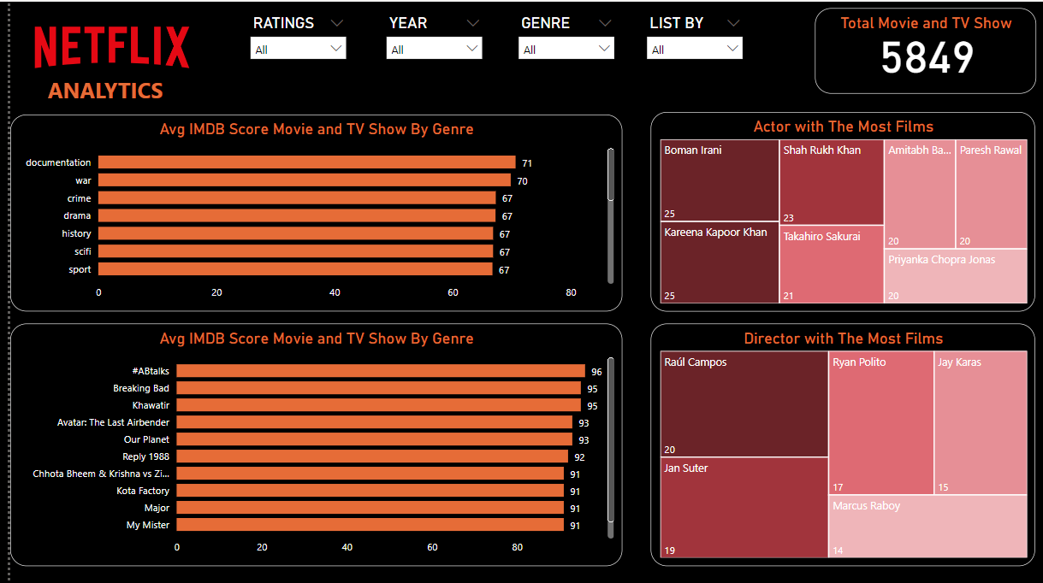
Avg IMDB Score
Films with documentation and war genres are the most popular genres.

Slide 19
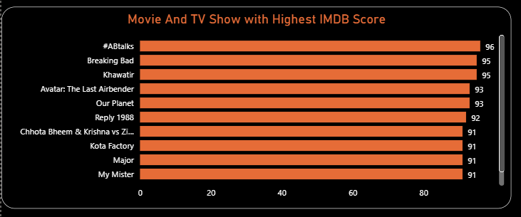
Highest IMDB Score
#ABtalks is the film with the highest IMBD score which means that this film is much liked by the audience. Then followed by Breaking Bad and Khawatir.

Slide 20
Actor and Director with Most Movie and TV Show
Boman Irani and Kareena Kapoor Khan are the actors with the highest number of films on Netflix.
While Raul Campos is the director with the highest number of films.

Slide 21
1
CONCLUSION
04

Slide 22
CONCLUSION AND SUGGESTION
If you are looking for the latest movies then Netflix can help you. Because the majority of movies on Netflix are movies with the latest year.
The majority of movies here have rating scores above 9, so you don't have to worry about the quality of movies on Netflix.
If you are a lover of drama or comedy genres, Netflix is able to give you many choices because there are more than 1000 movies here with drama and comedy genres.
For Hollywood movie lovers, you don't need to worry because more than 1000 films here are produced in the United States.

Slide 24
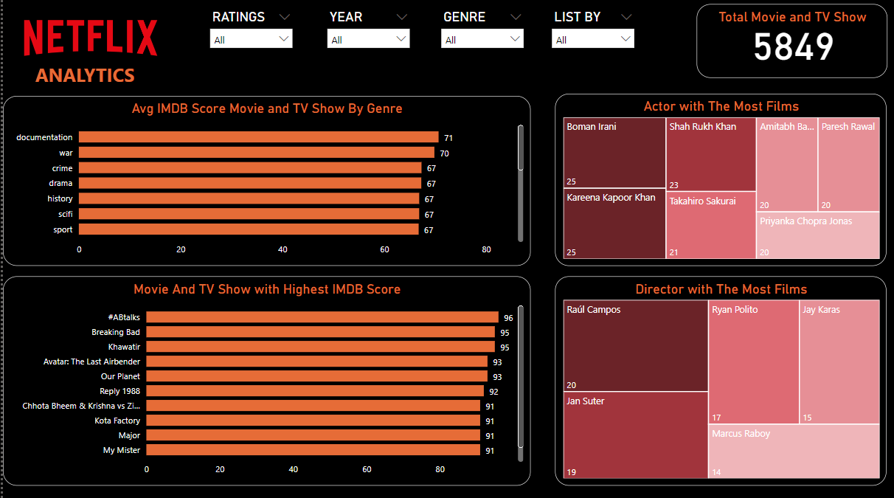

Slide 25

HOW ABOUT THE QUERIES?
Home
About me
What I do
My experience
My work
You can see the queries in next slides

Slide 26
ANALYSIS With SQL QUERIES
Home
About me
What I do
My experience
My work

Slide 27
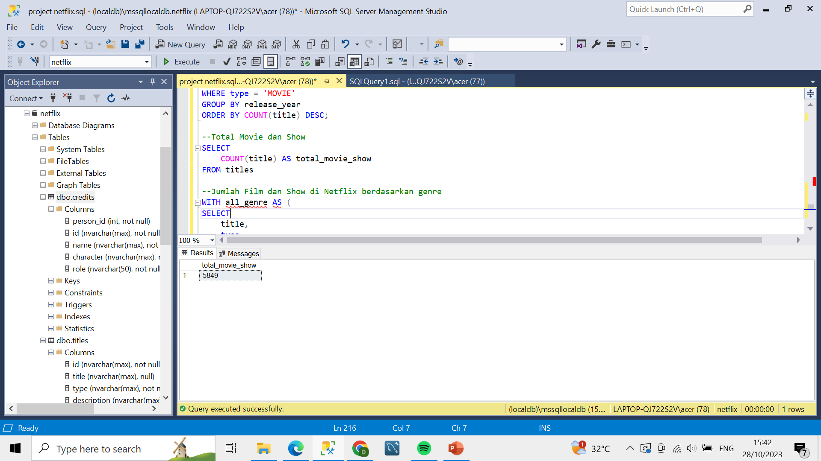
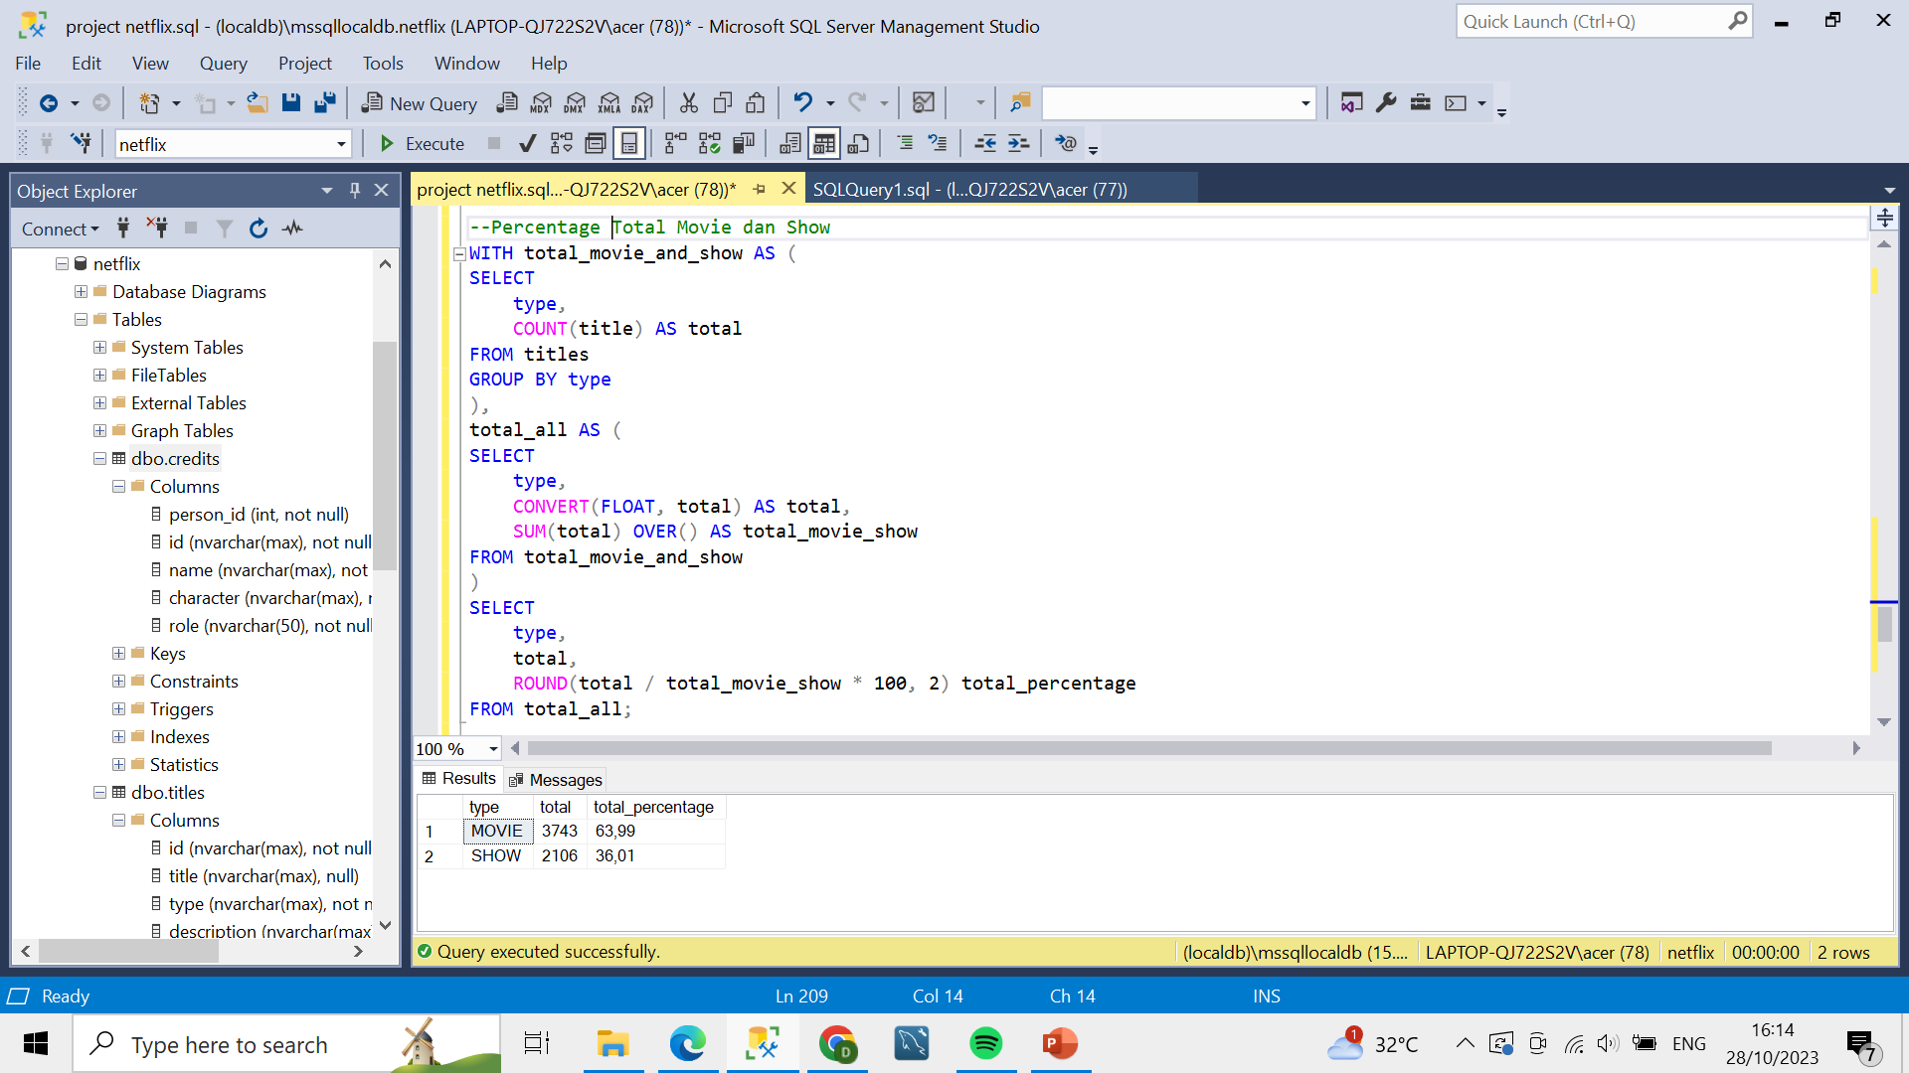
Total Movie and Show
All Movie and Show
Percentage Movie and Show
Result
Result

Slide 28
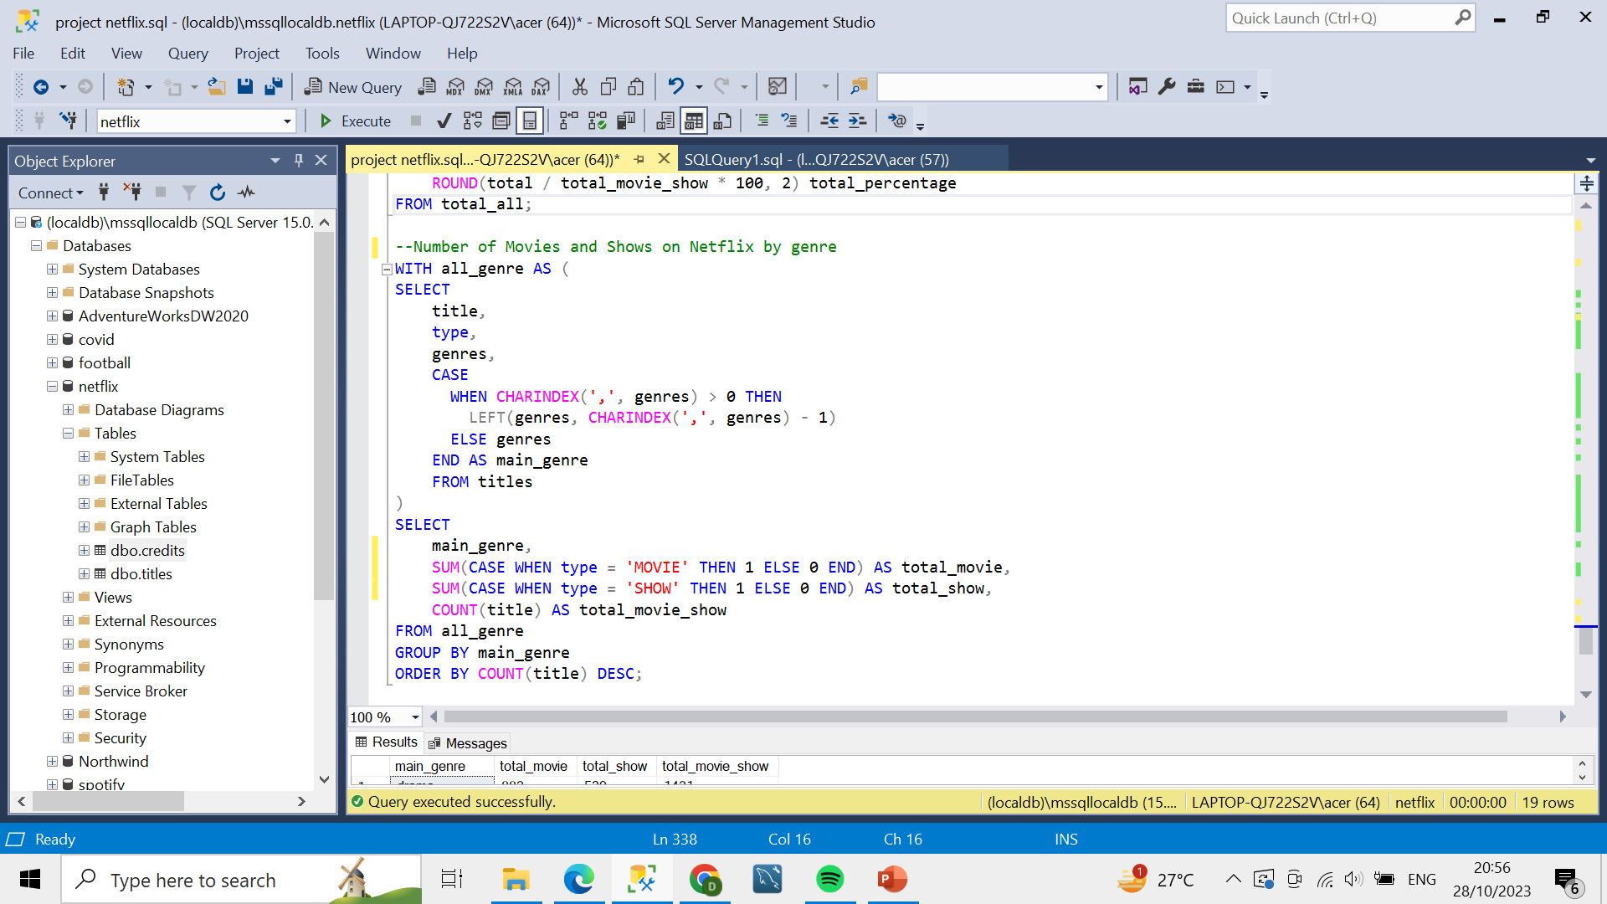
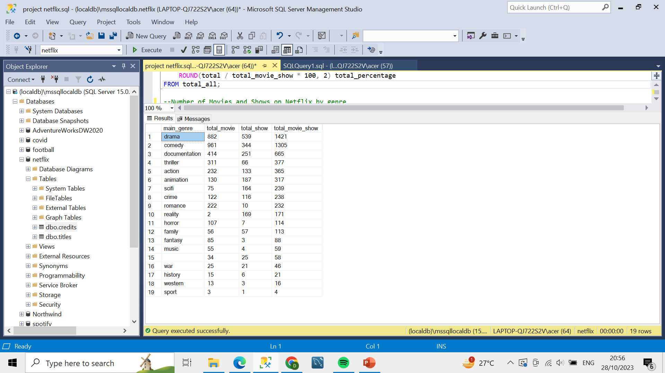
Total Movie and Show by Genre
Query
Result

Slide 29
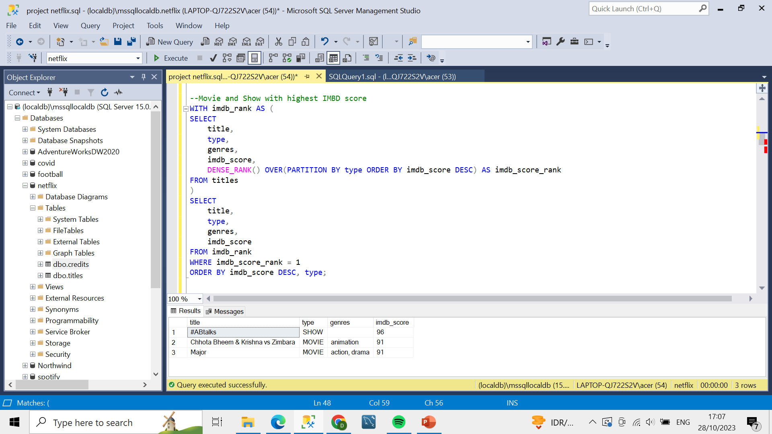
Movie and Show Highest IMDB Score
Query
Result

Slide 30
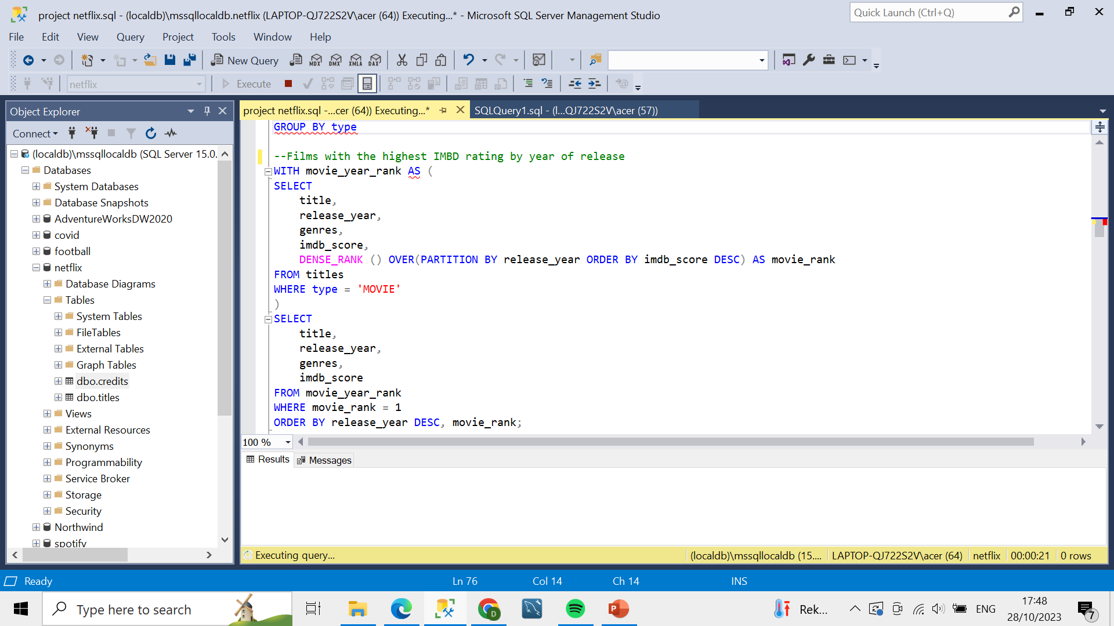
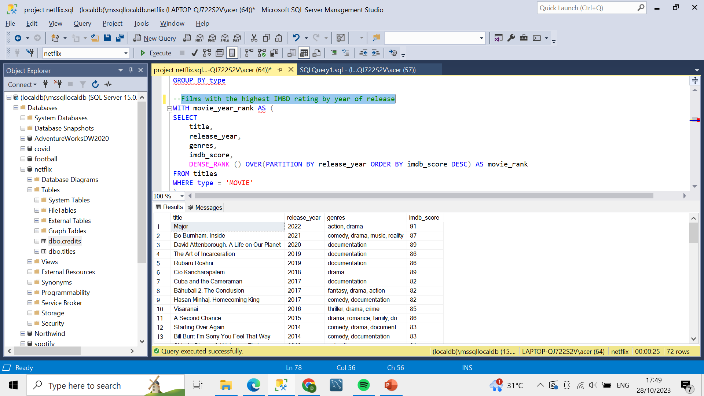
Movies with the Highest IMBD Score by Year of Release
Query
Result

Slide 31
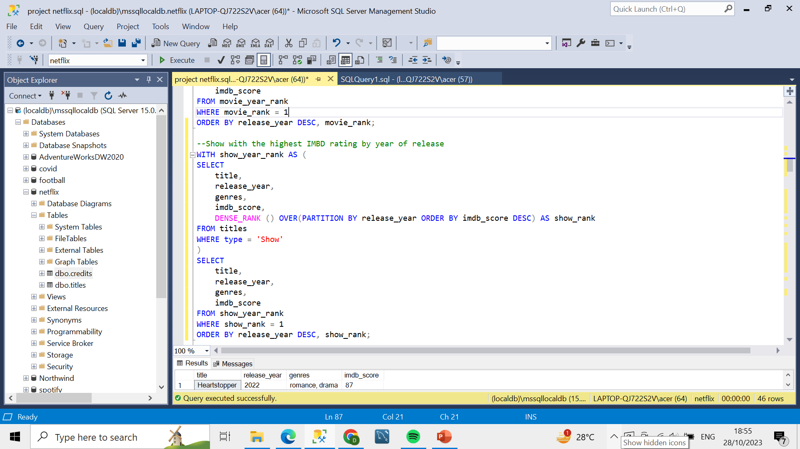
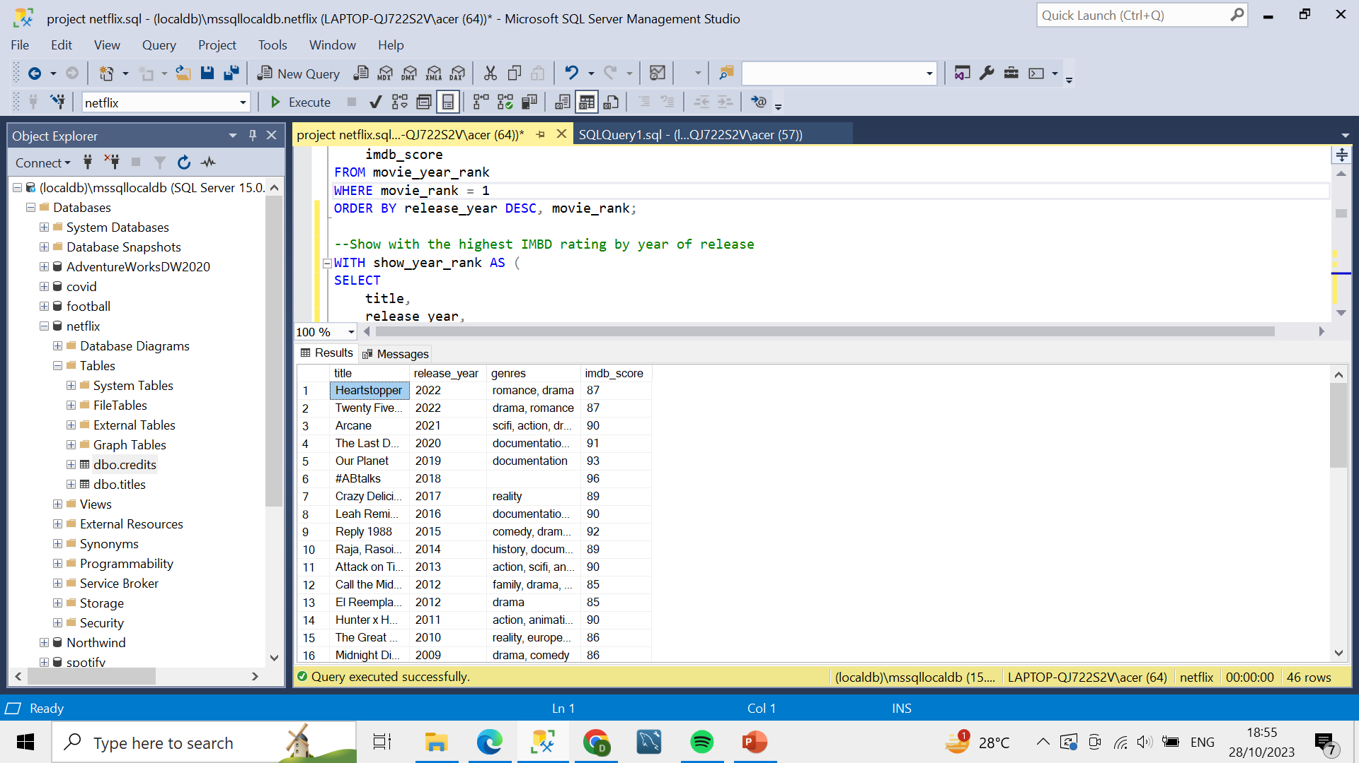
Shows with the Highest IMBD Score by Year of Release
Query
Result

Slide 32
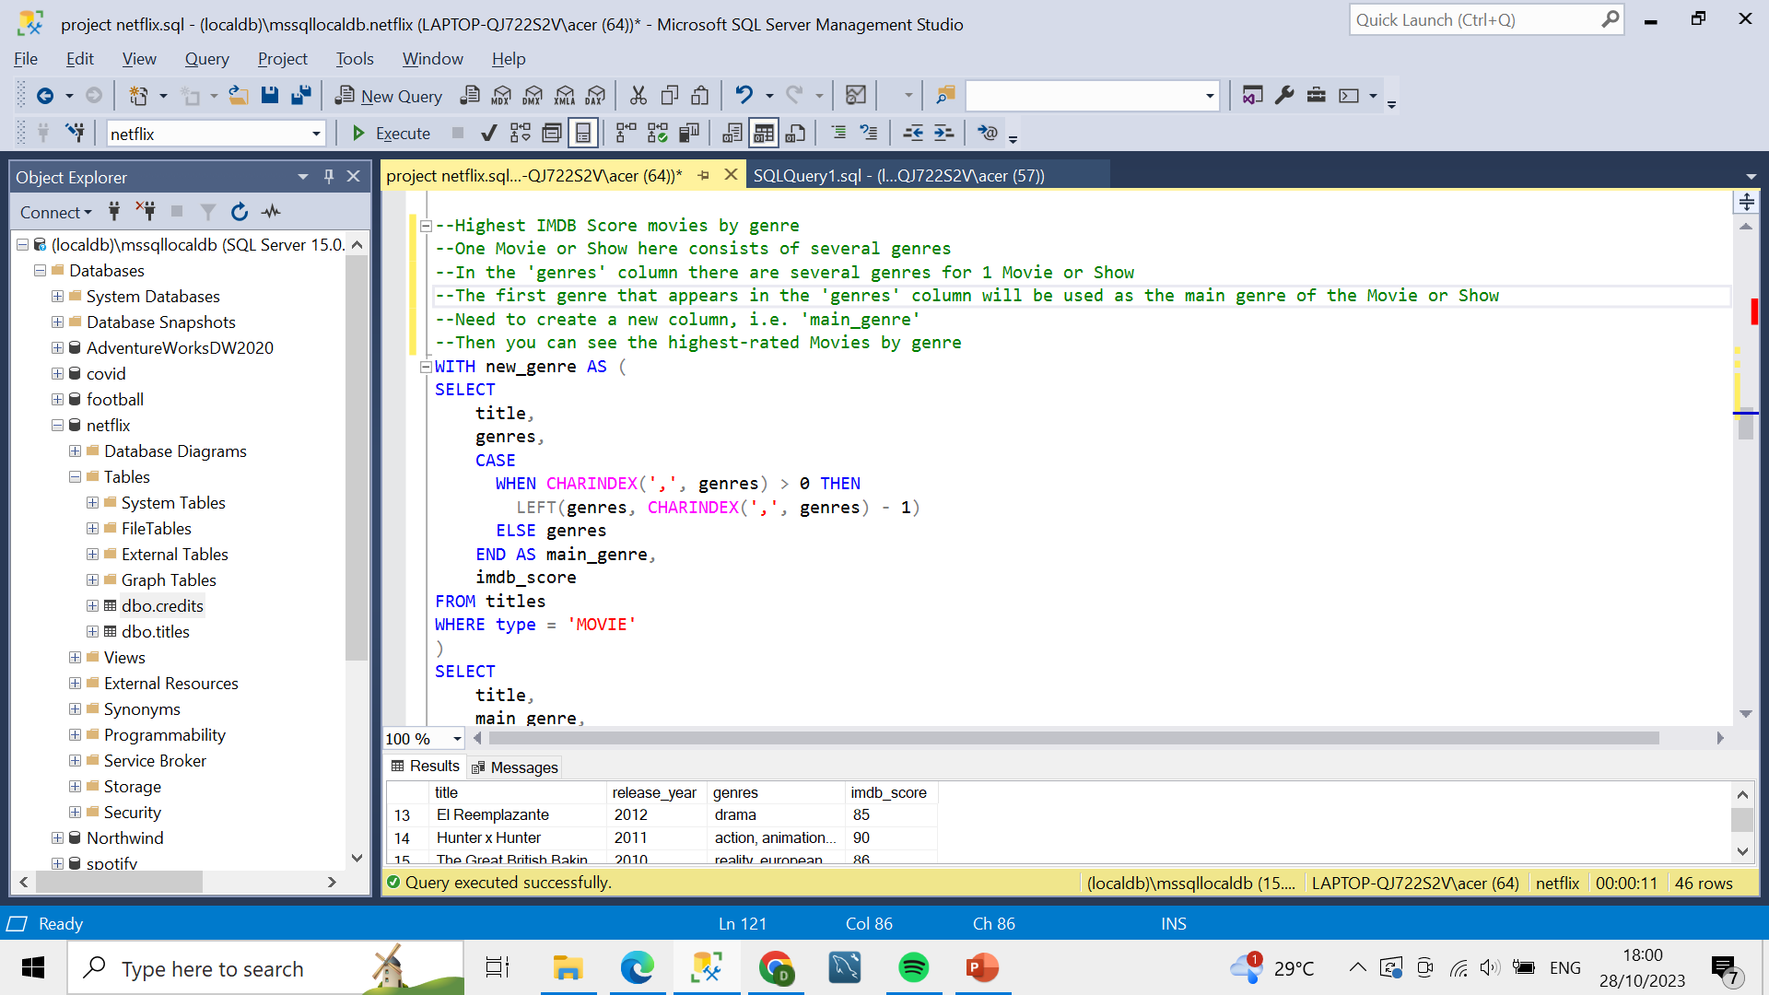
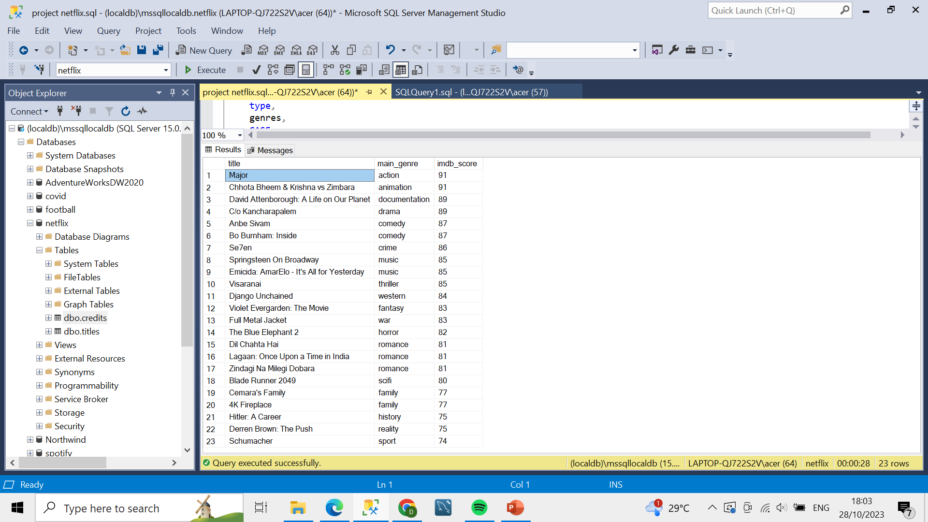
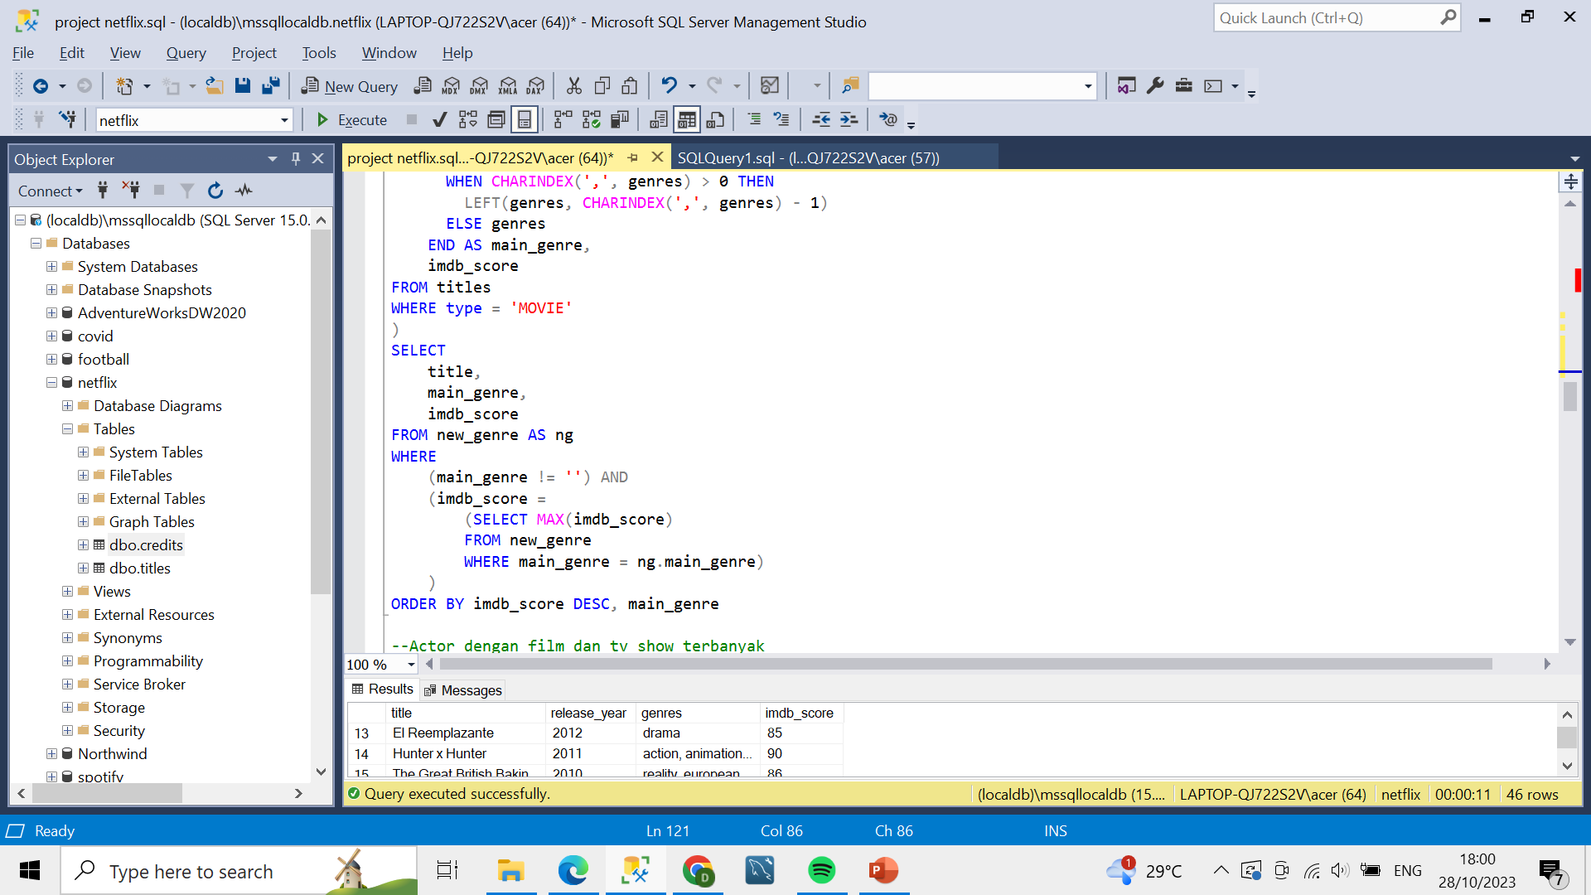
Movie with the Highest IMBD Score by Genre
Query
Result

Slide 33
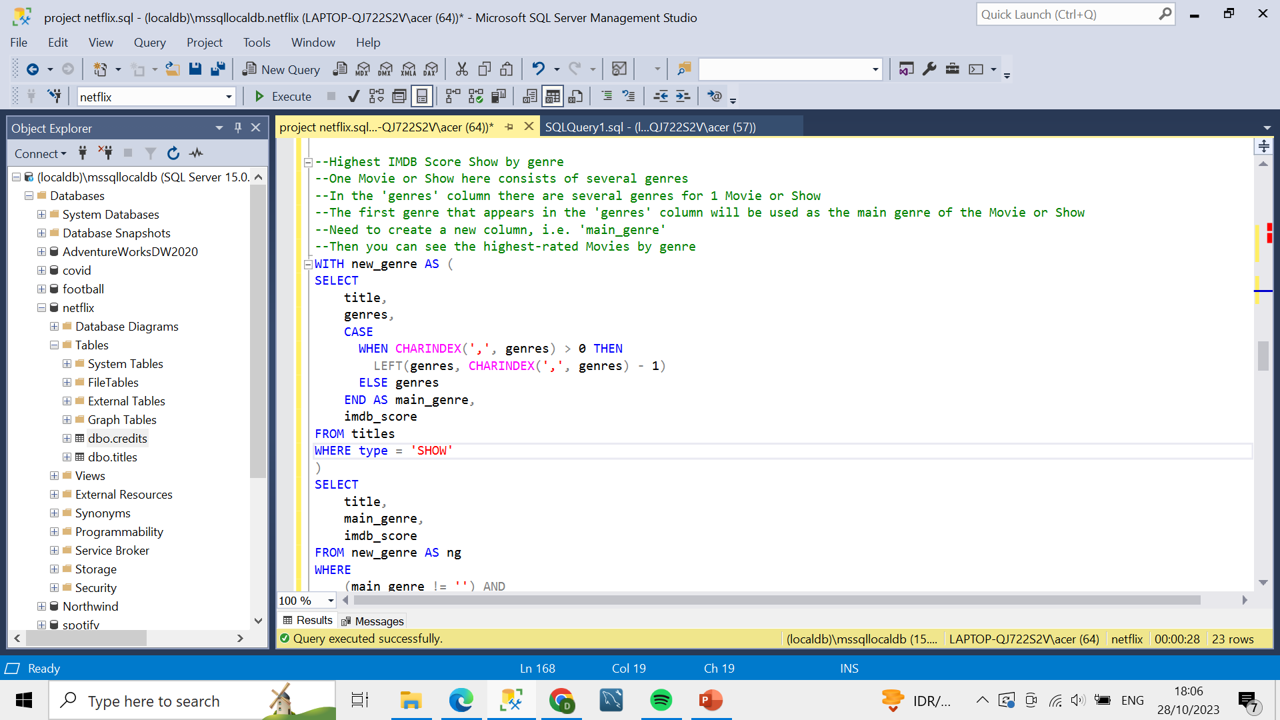
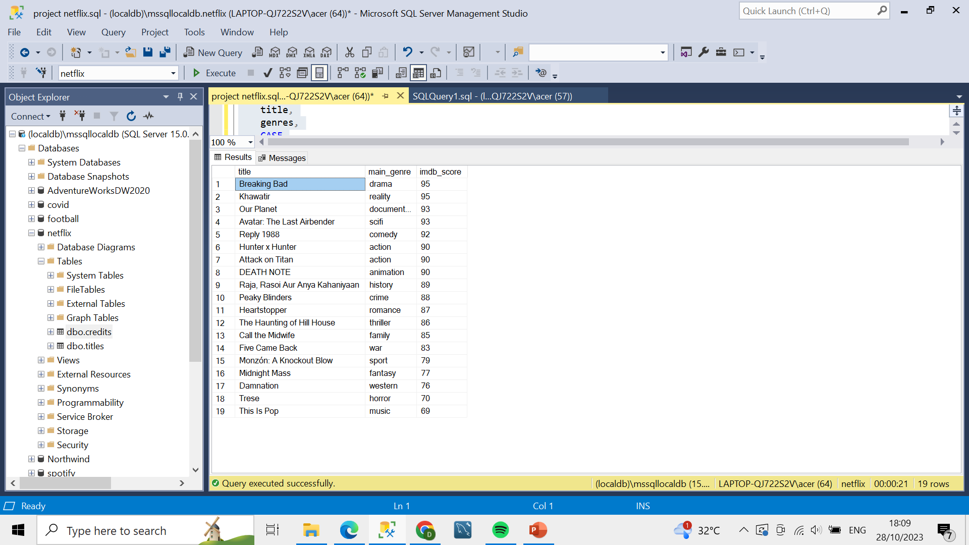
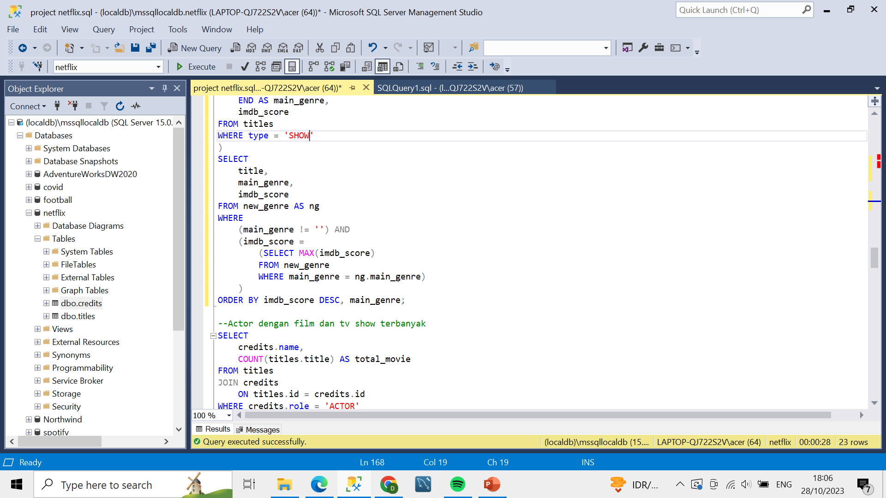
Show with the Highest IMBD Score by Genre
Query
Result

Slide 34
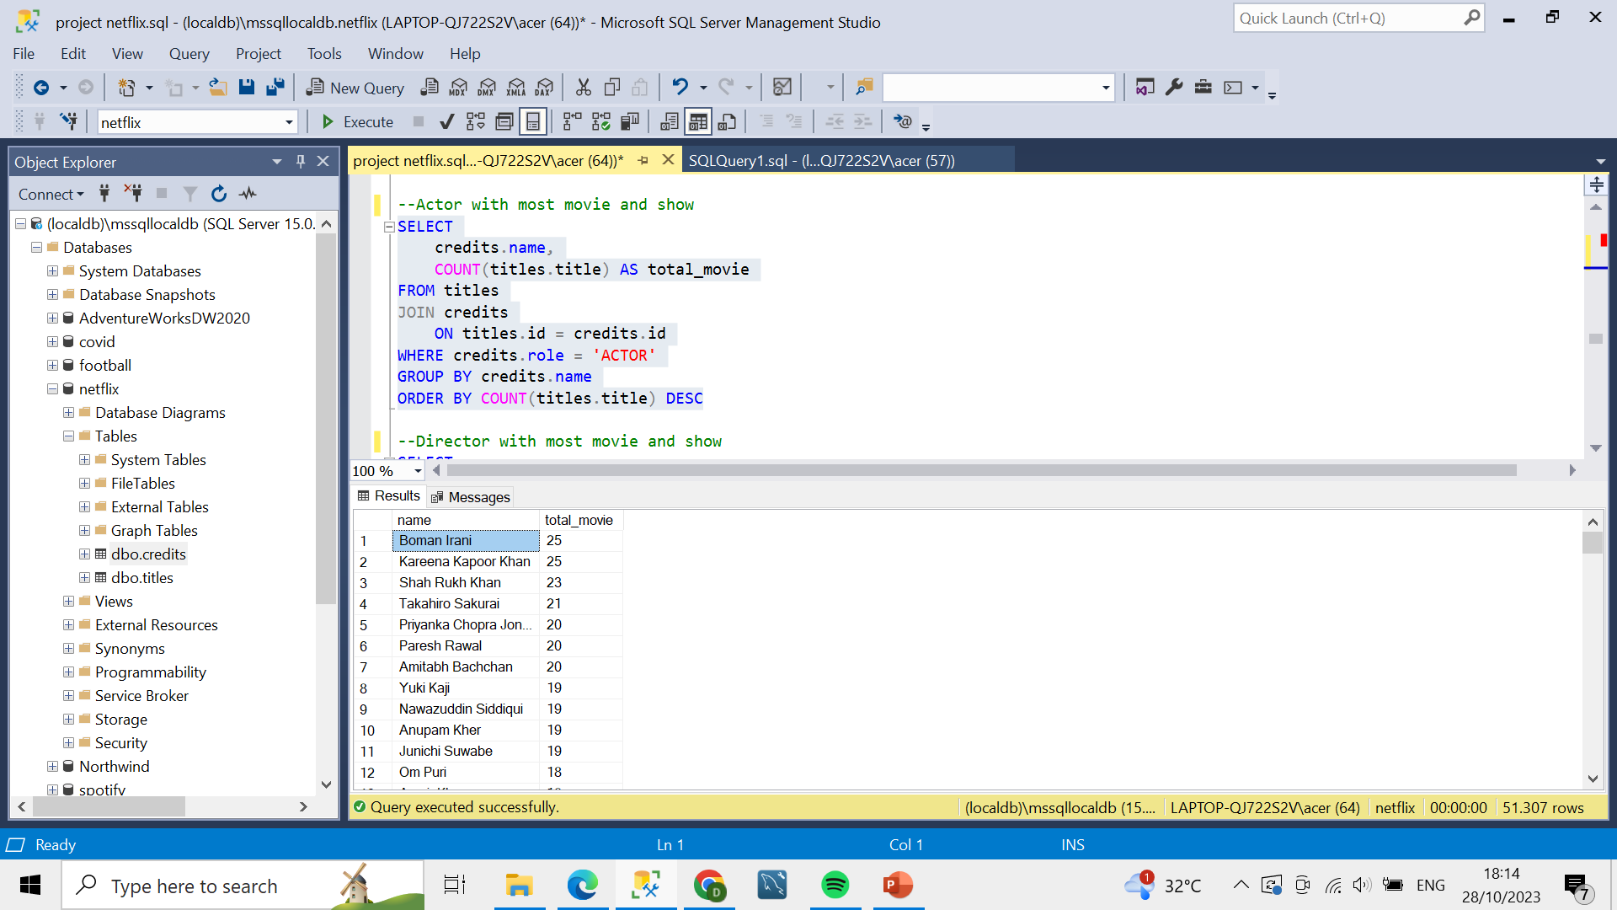
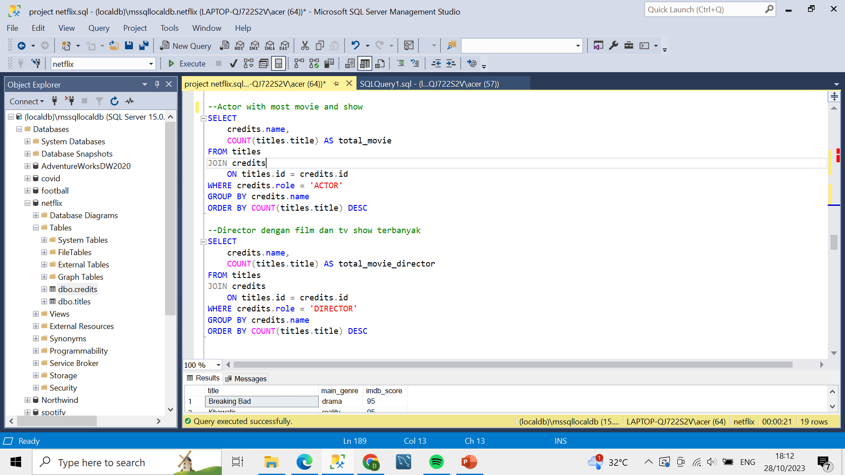
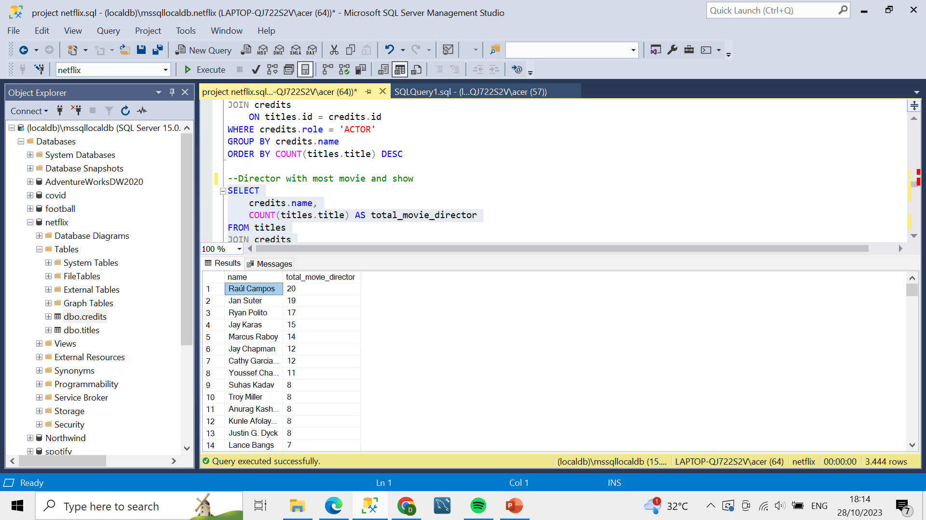

Actor and Director with Most Movie and Show
Query
Result

Slide 35
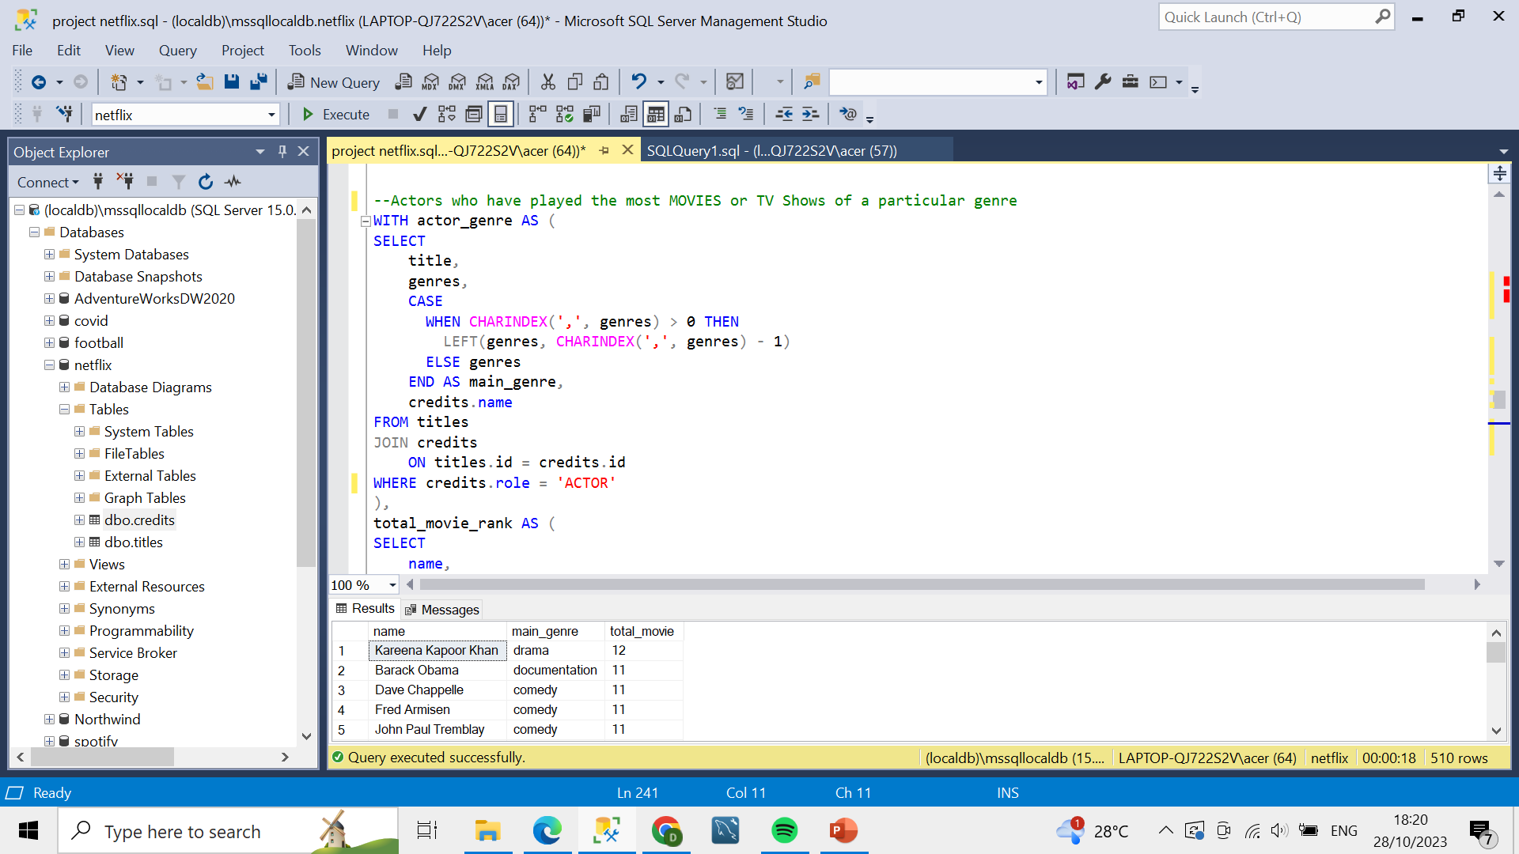
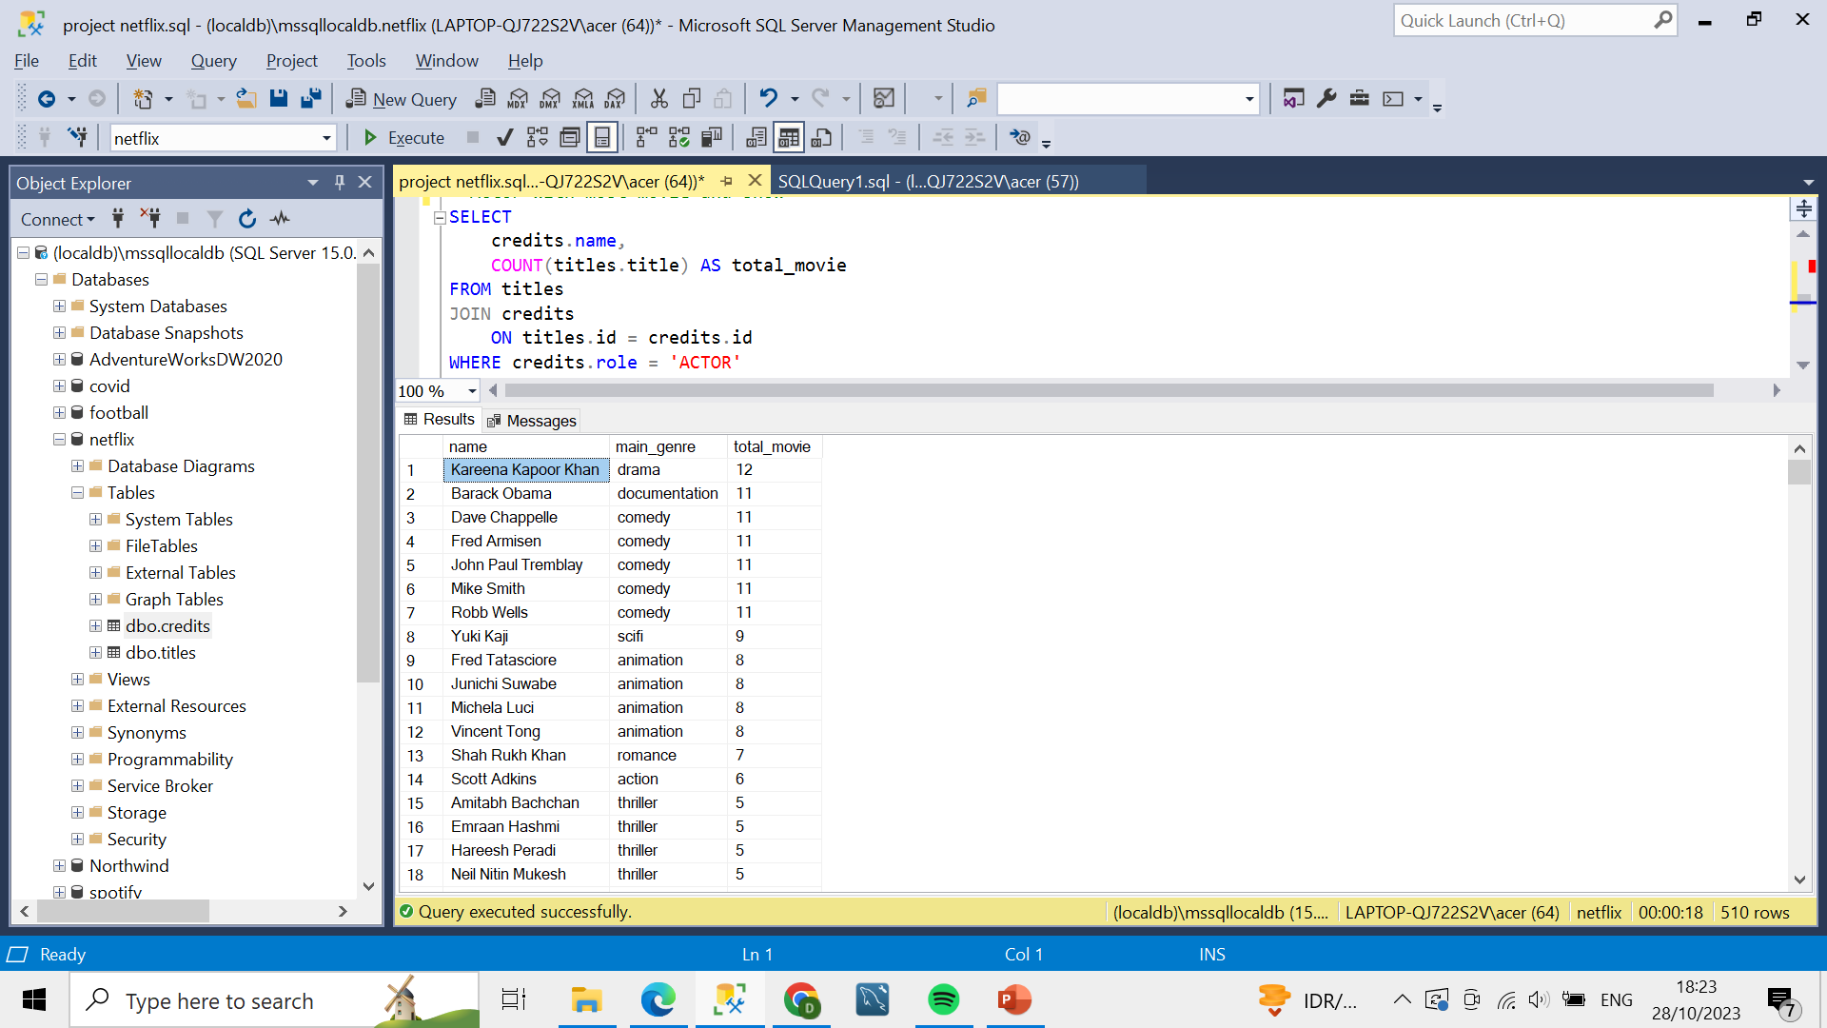
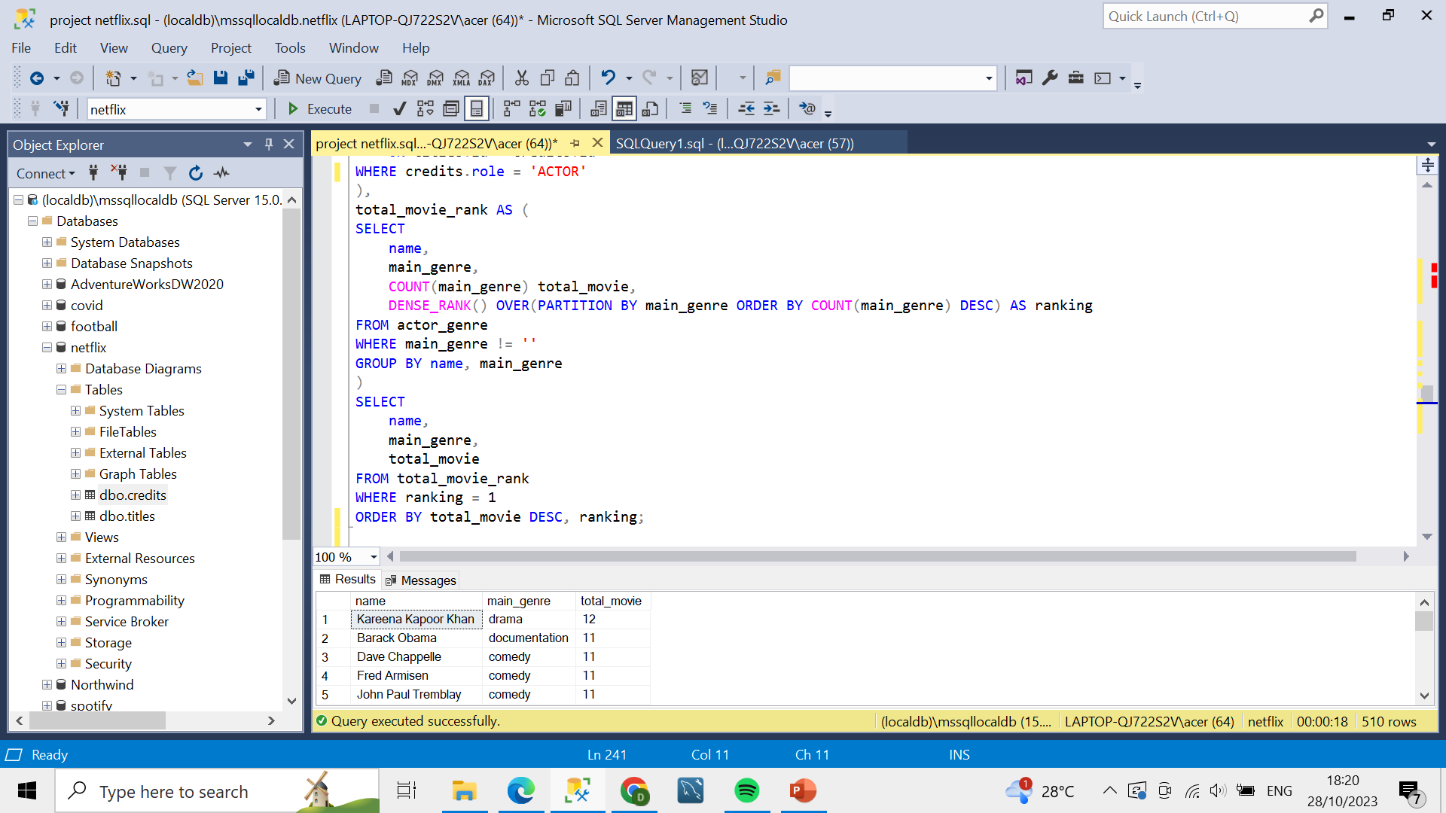
Actor with Most Movie and Show by Genre
Query
Result

Slide 36
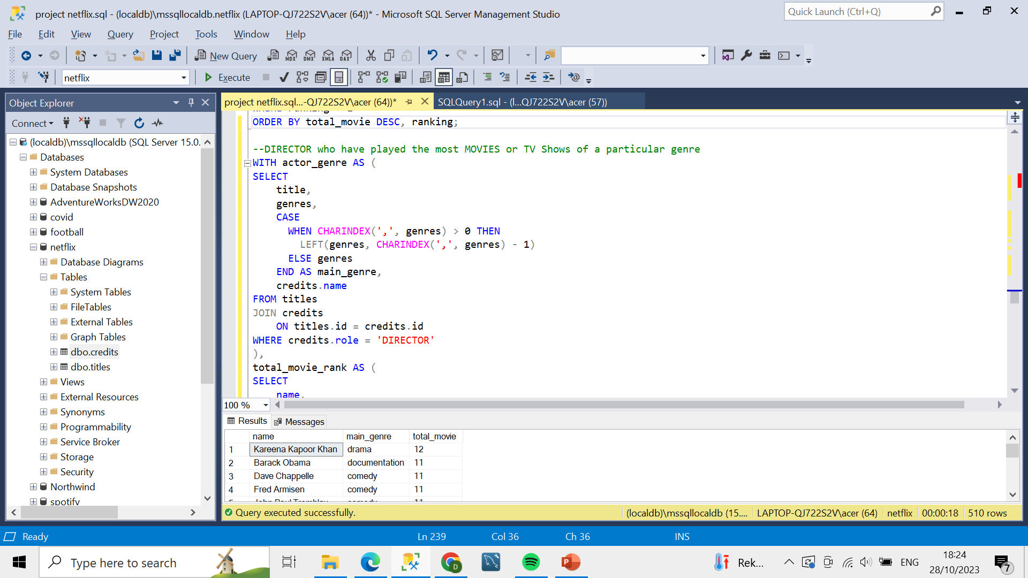
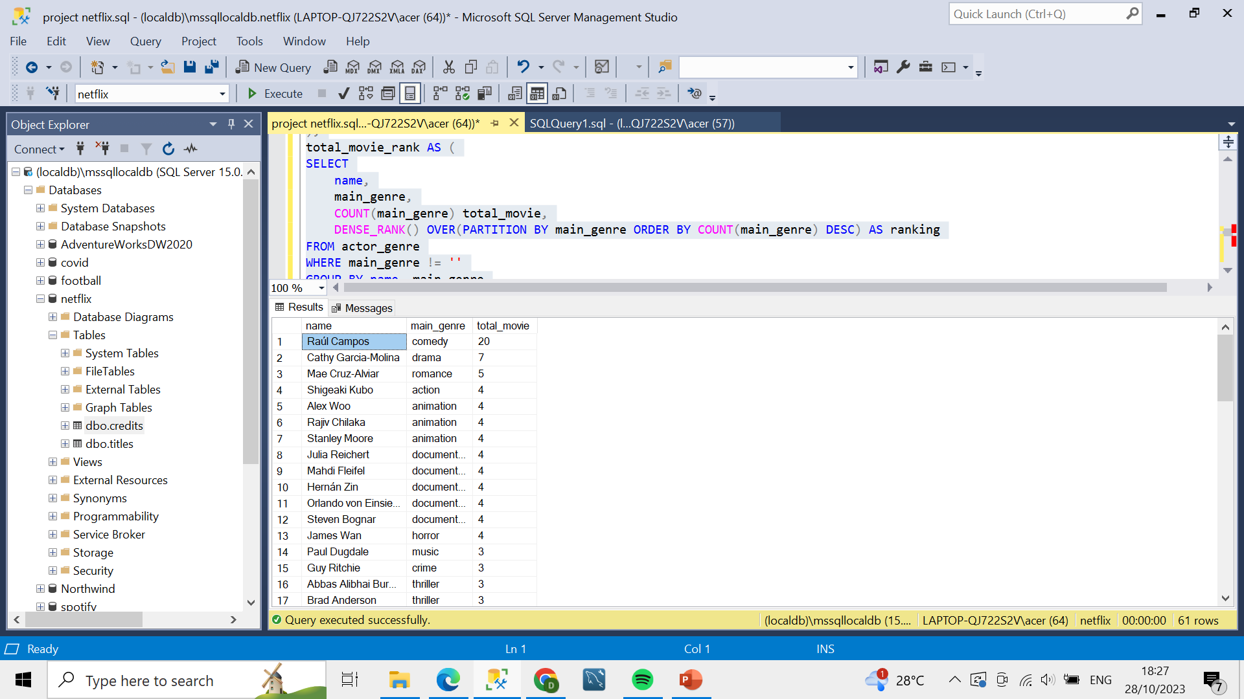
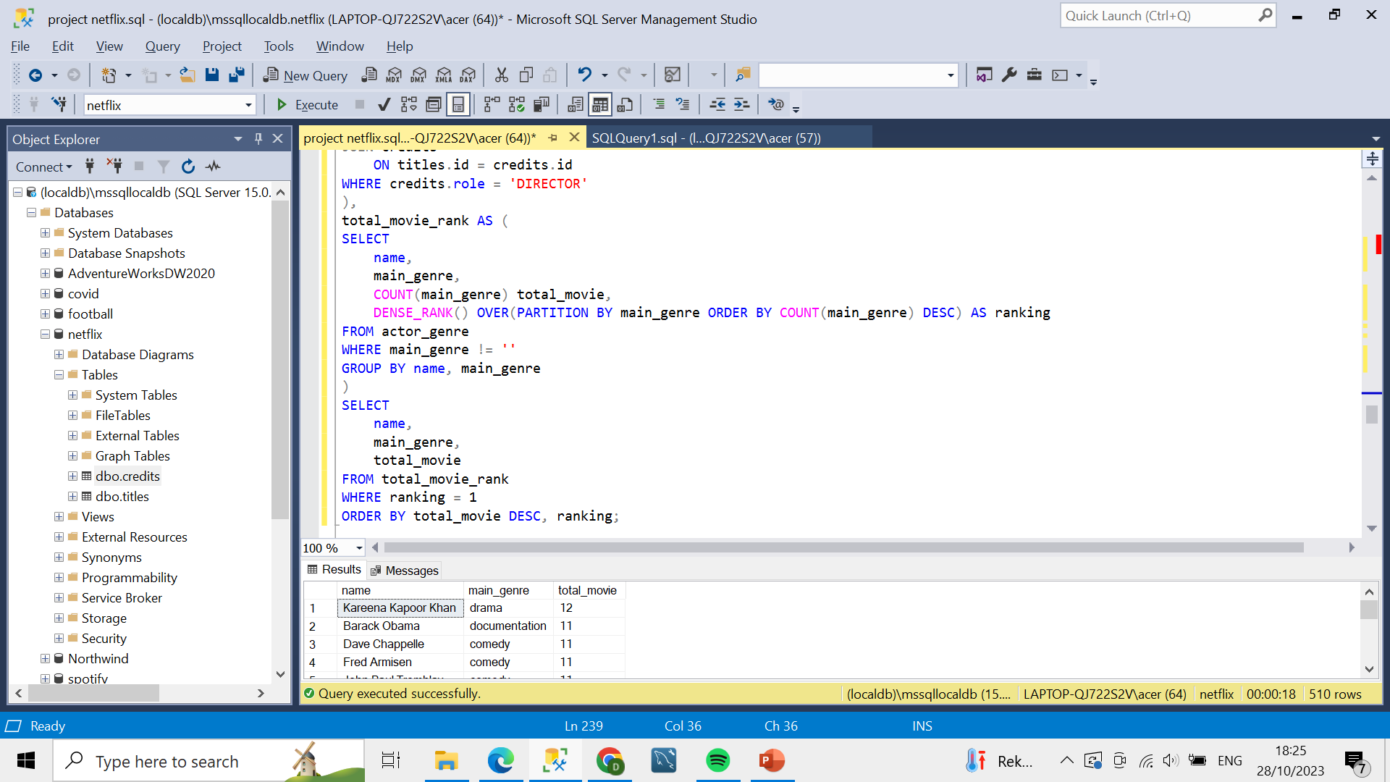
Director with Most Movie and Show by Genre
Query
Result

Slide 37
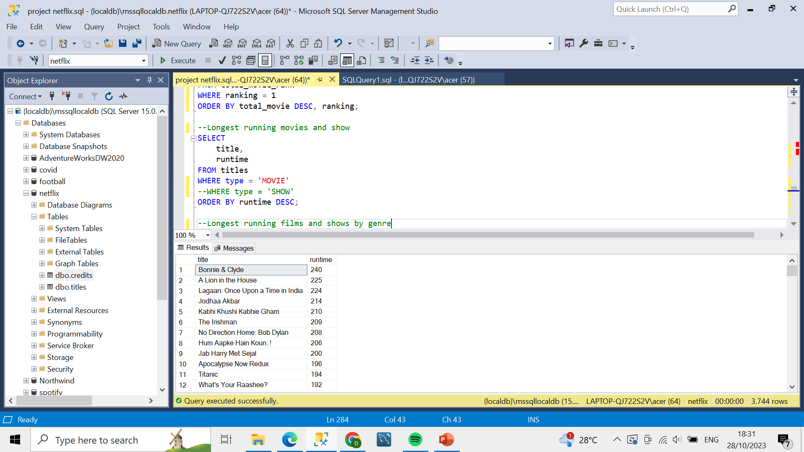
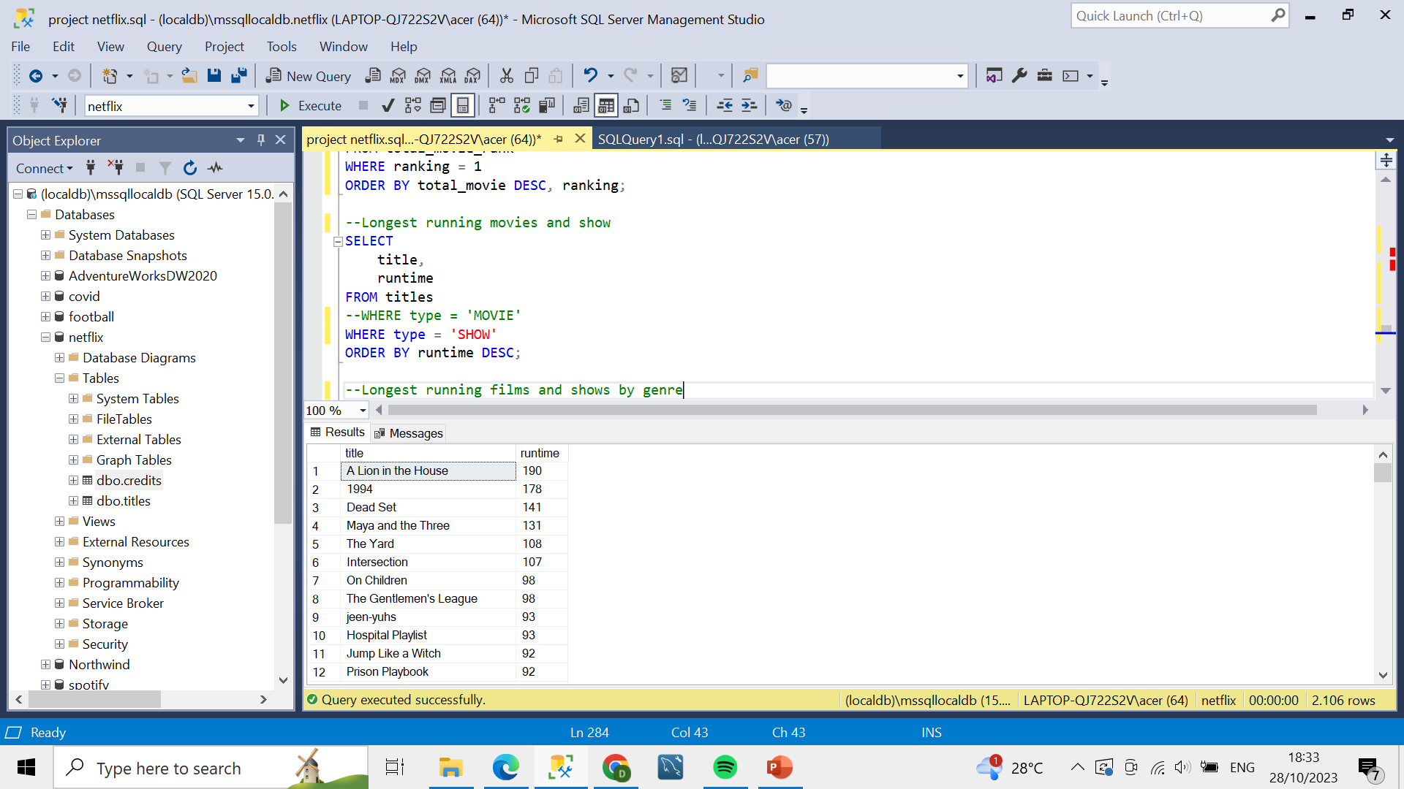
Longest Running Movies and Shows
Movie
Show

Slide 38
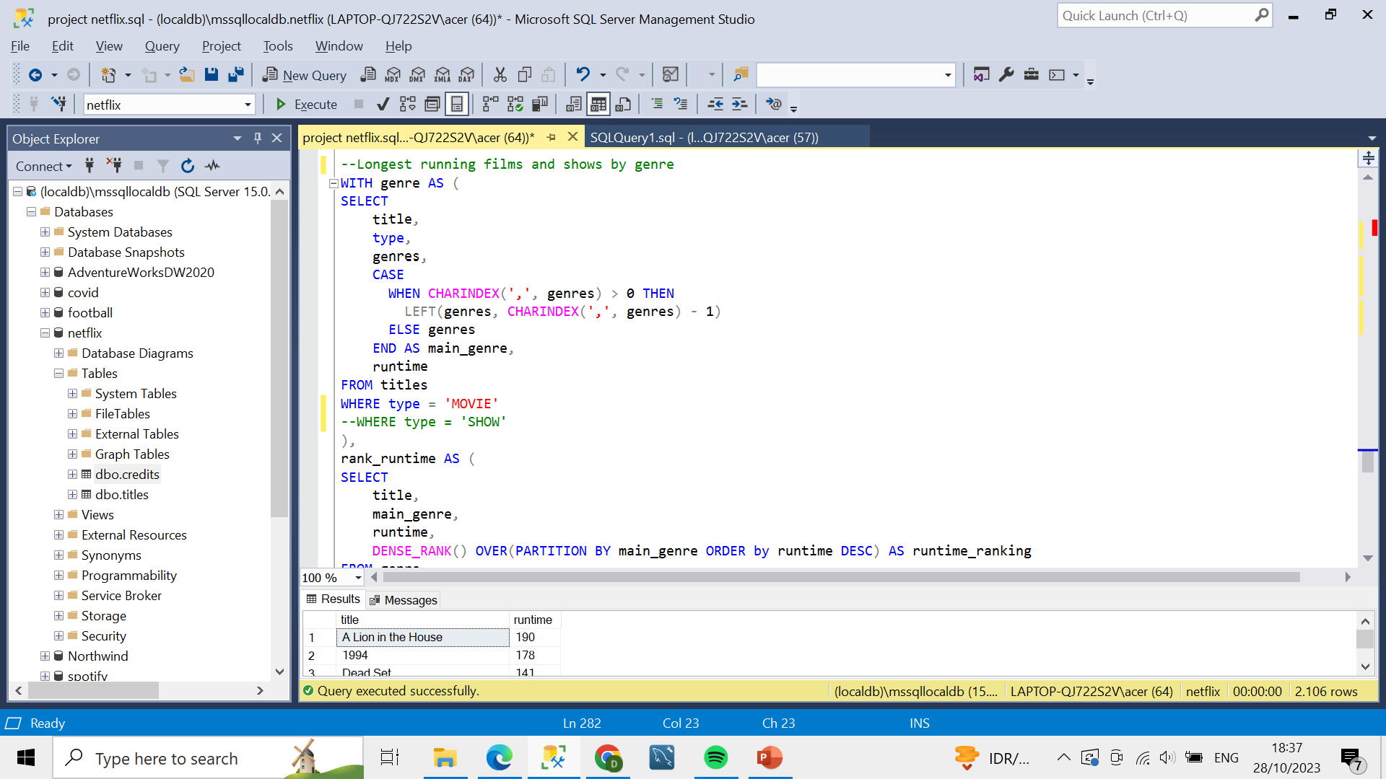
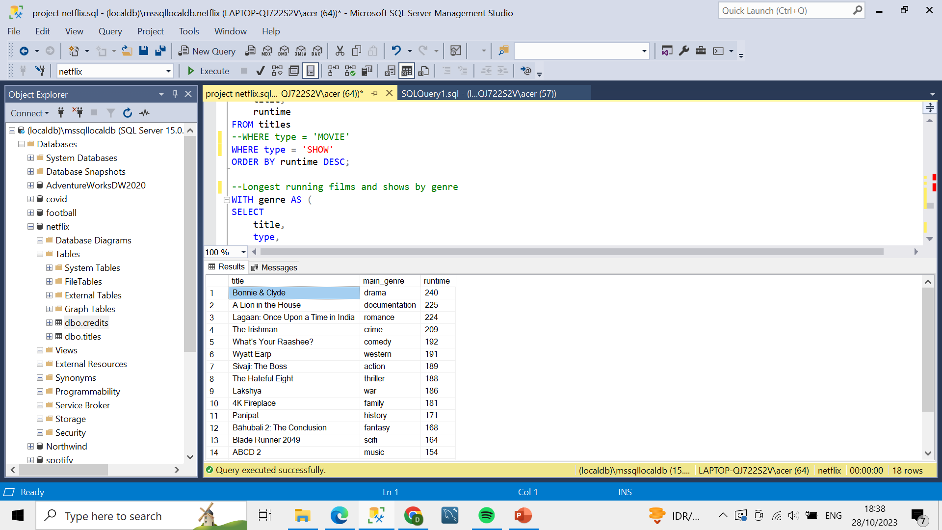
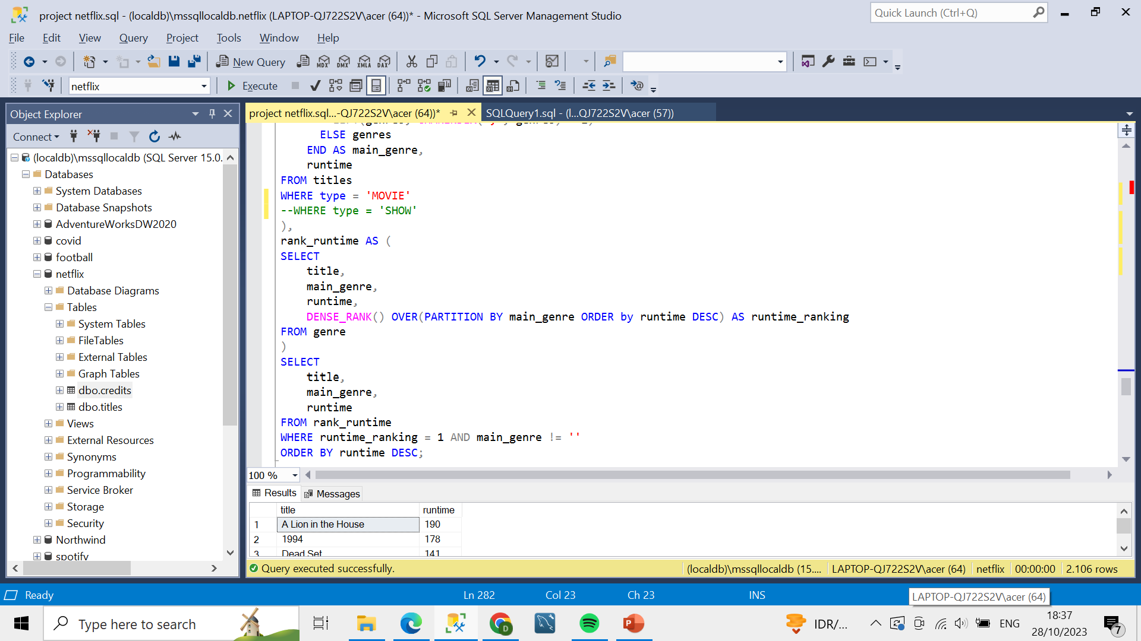
Longest Running Movies by Genre

Slide 39
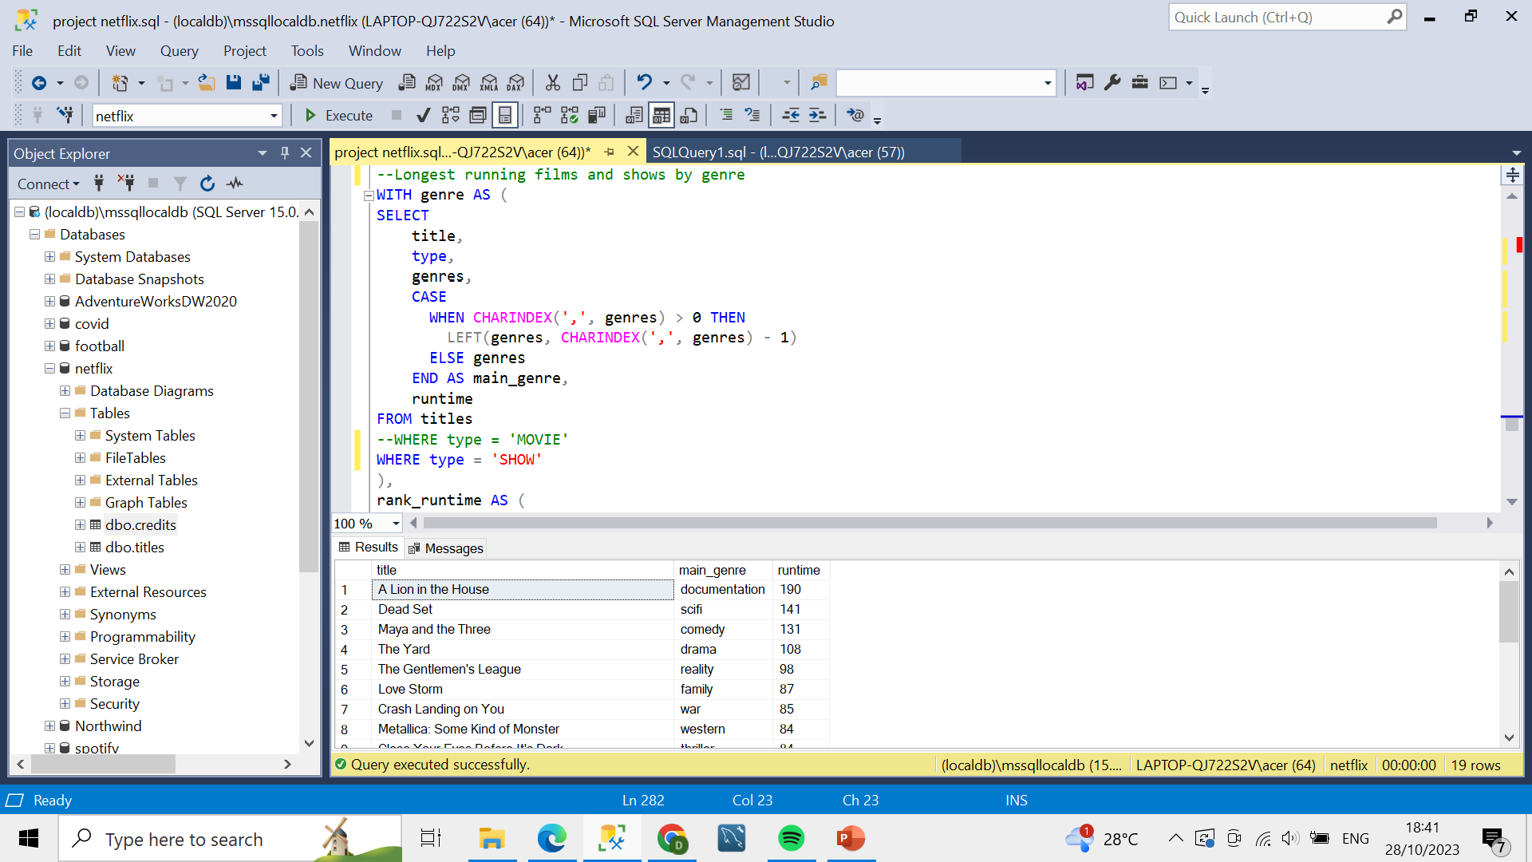
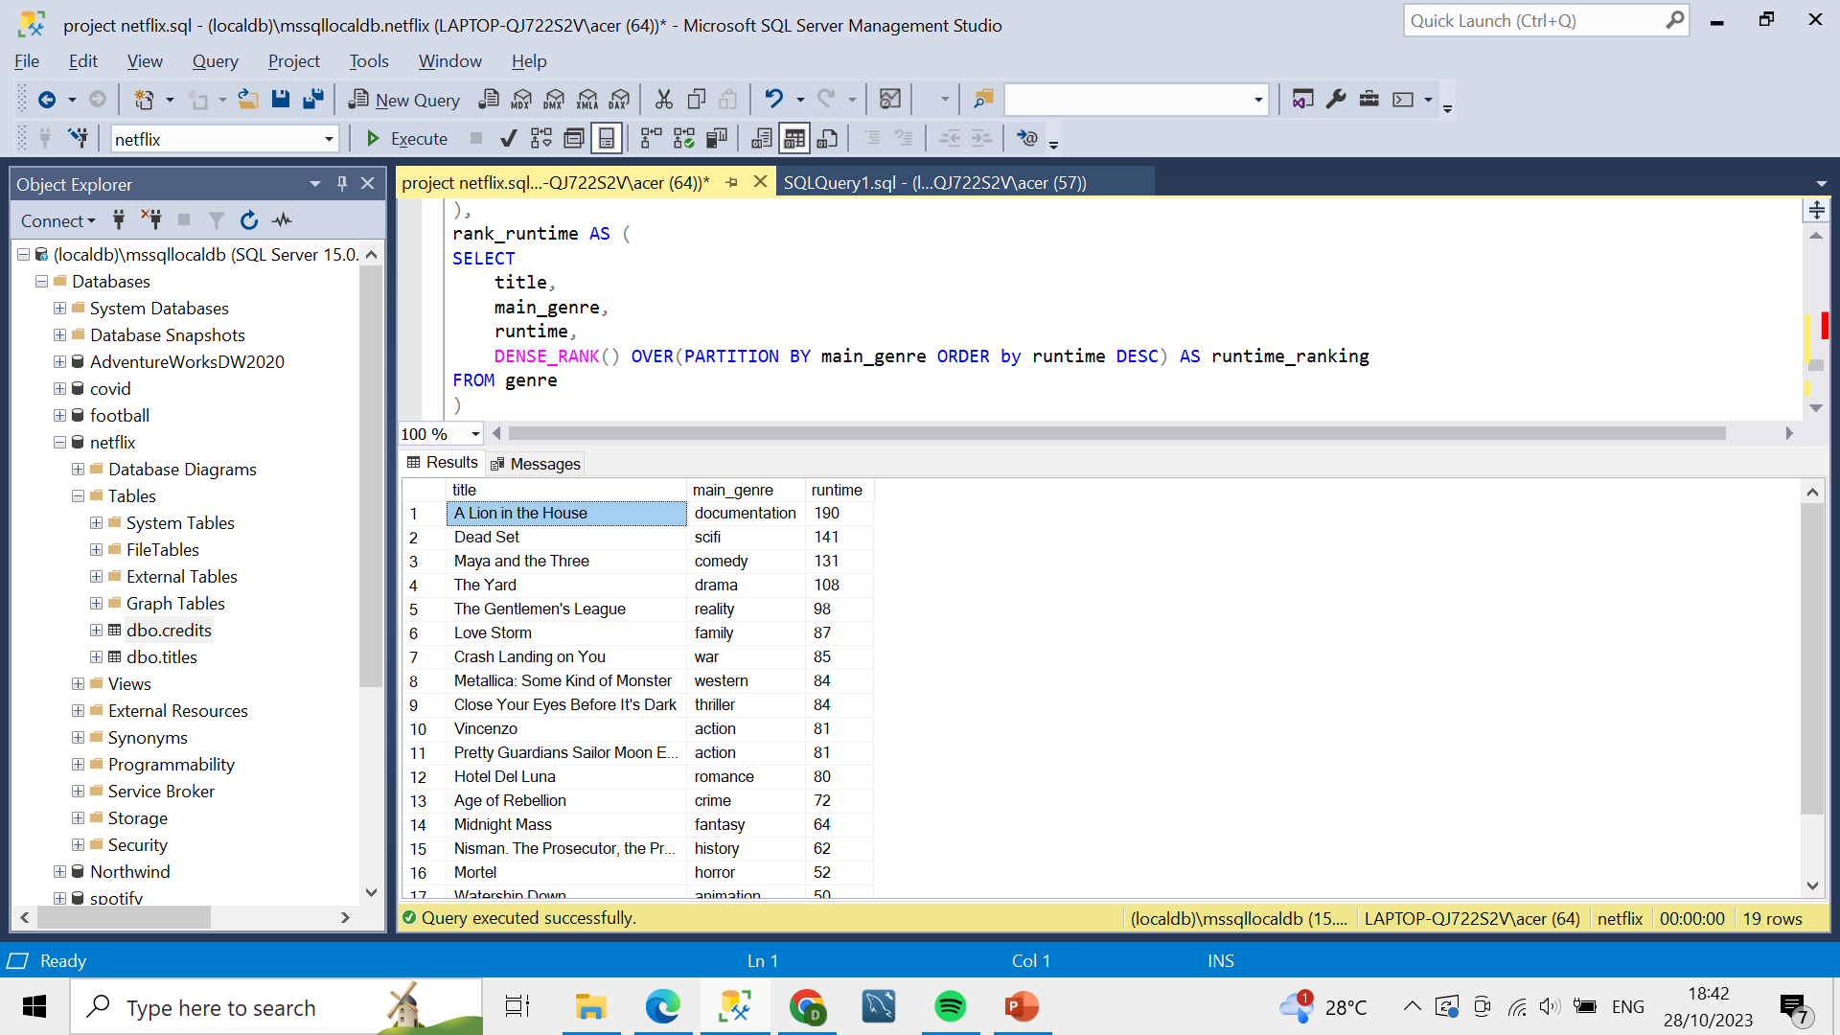
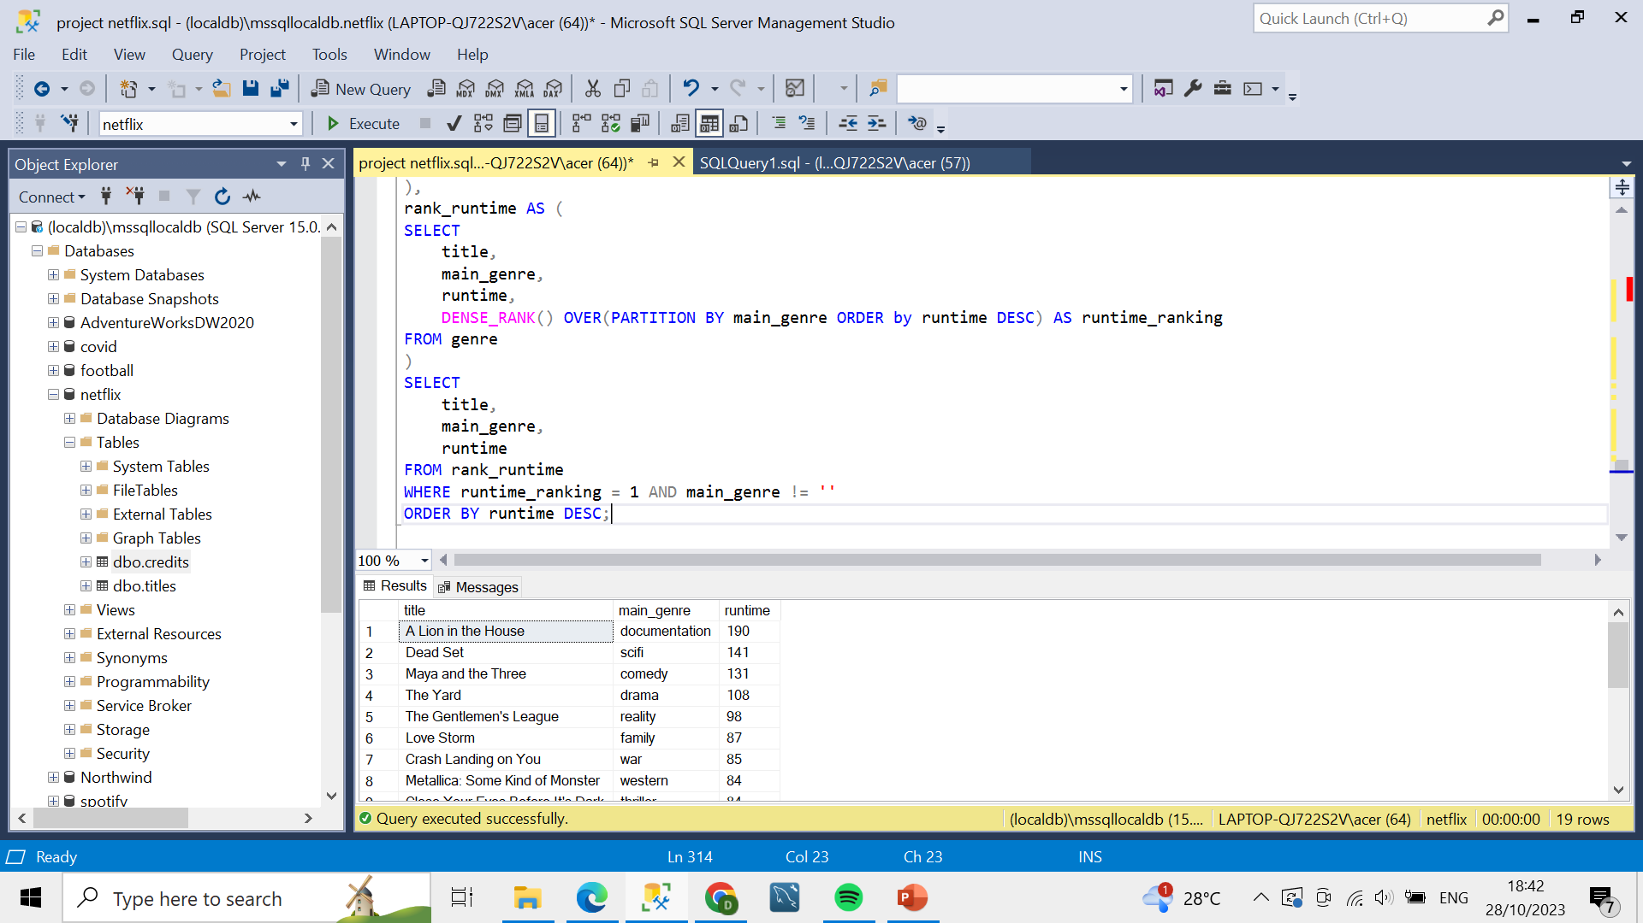
Longest Running Shows by Genre

Slide 40
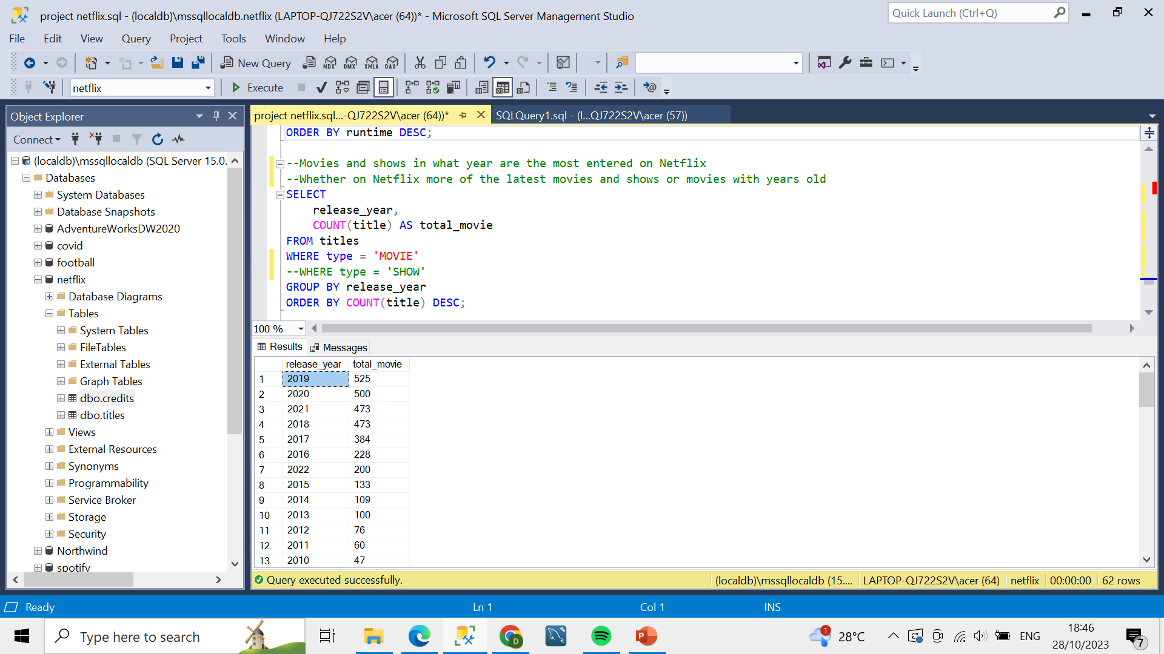
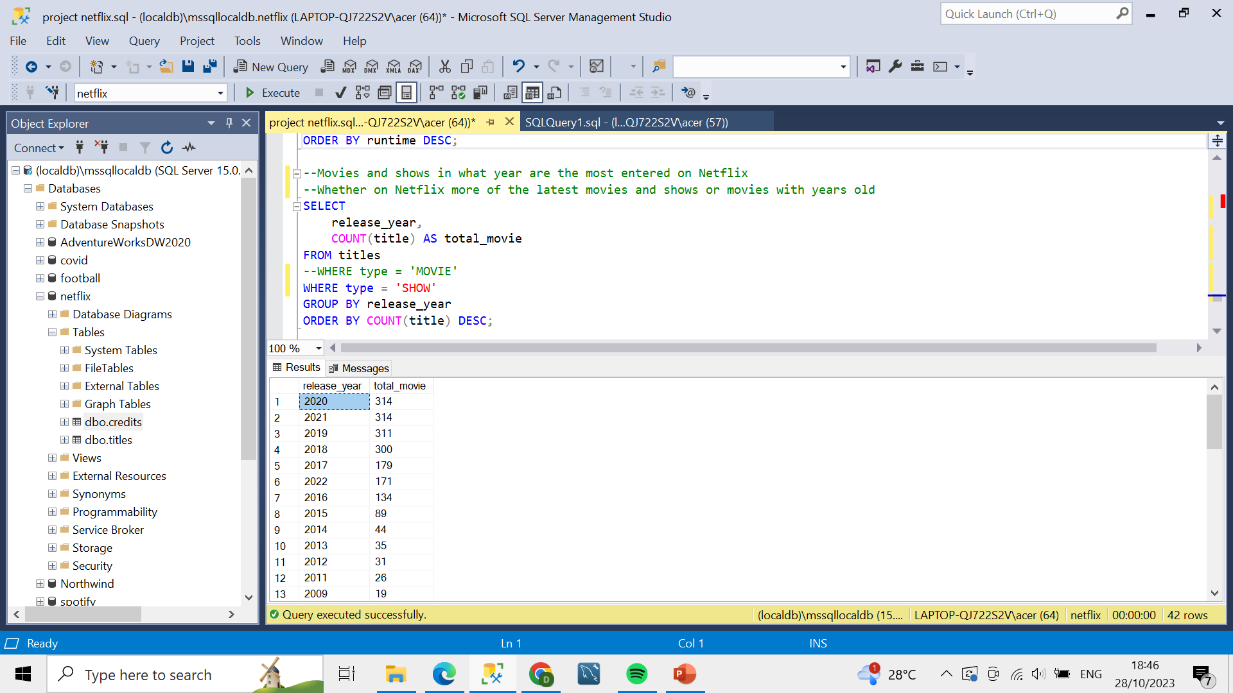
Movies and Shows with the Most Years Produced
Movies
Shows

Slide 41


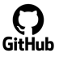
Home
About me
What I do
My experience
My work
THANKS!
Do you have any questions?
Find me at:
http://www.linkedin.com/in/dicky-alvion-a53215245
dickyabrar11@gmail.com
https://github.com/dickyalvion
Full Dashboard and Queries:
https://github.com/dickyalvion/netflix-analytics

